Slide 1
IMPRESA IN TURKEY
SUMMARIZED RESEARCH FINDINGS for 2021-22 GROWING SEASON
7-9 February 2023 (Great earthquake dIsaster)
31 May 2023

Slide 2
dısposıtıon
1. Aim of the project
2. Locations and meteorological characteristics for 2021-22 cropping season
3. Evaluation of field nurseries
3.1. Observation nursery
3.2. Yield trials-Grain yields
3.3. Yield trials-Quality

Slide 3
1. Aım of the project
General target: IMProving RESilience to Abiotic stresses in durum wheat
We as Turkish partner, aim to pick up good parents in exotic material and DW-WWR recombinants for direct use or germplasm development through crosses for resilience abiotic stress in the region

Slide 4
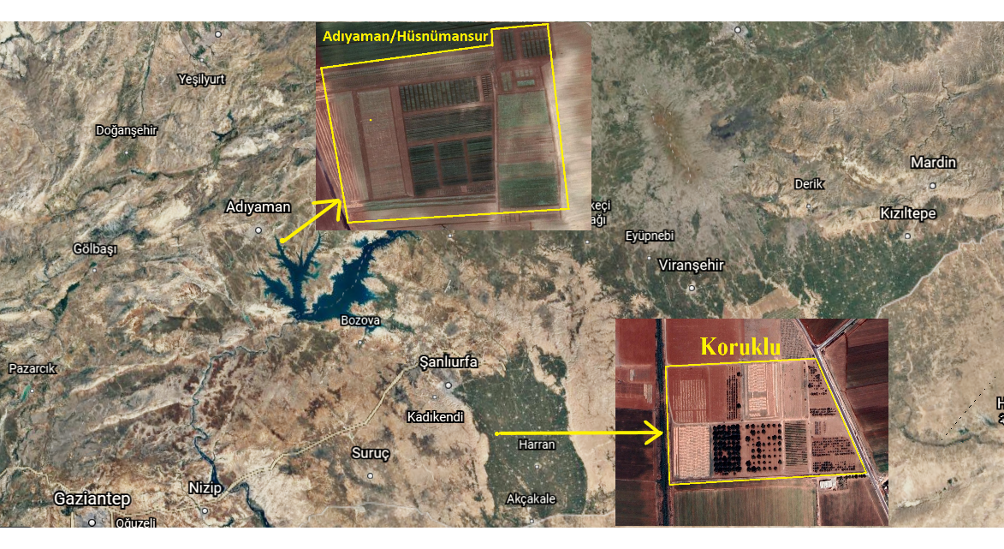
Location map

Slide 5


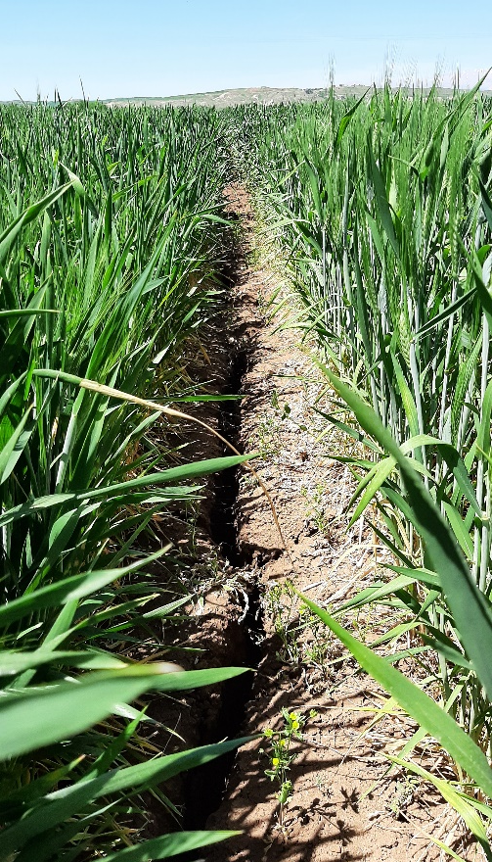
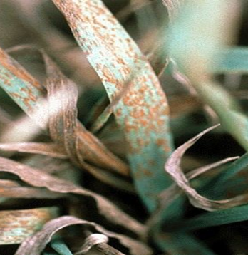
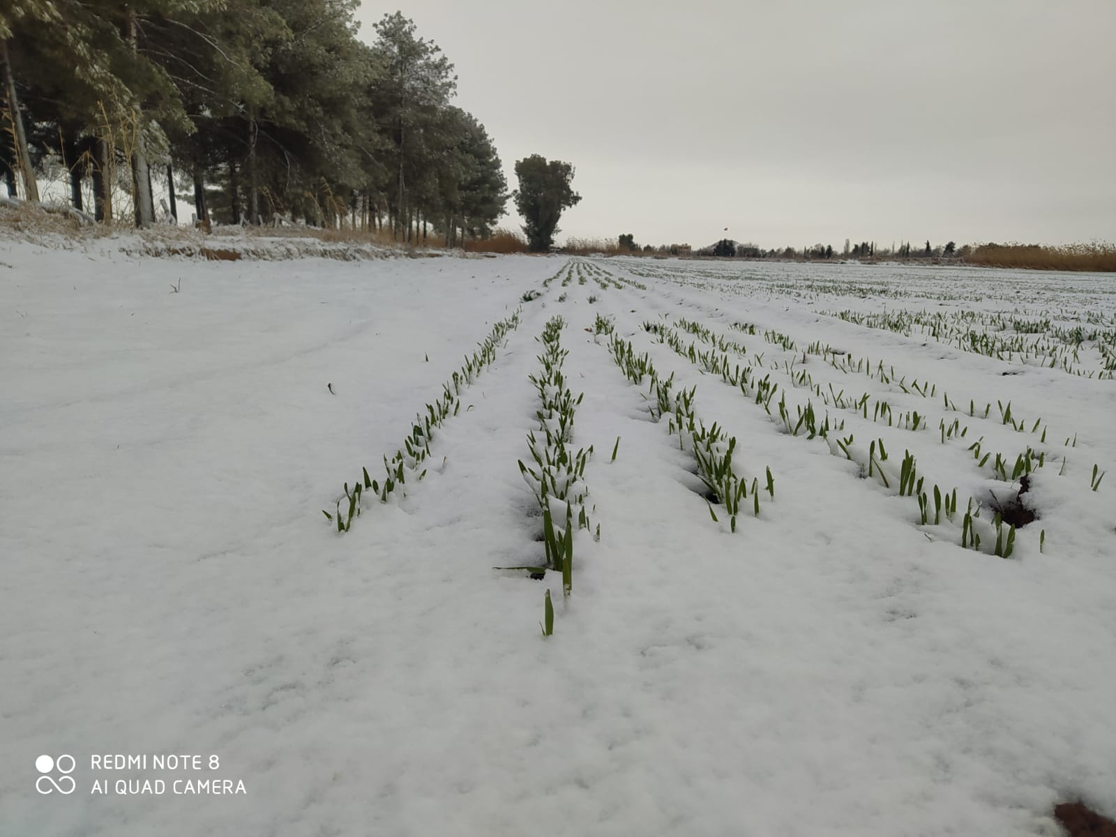
2. Experımental LocatIons
Koruklu (Sanlıurfa): sub station of GAP Training and Reseach Center ( N 36.88 Northern latitude and E 38.92 Eastern longitude)
Elevation from SL: 370 m (Koruklu)
Annual rainfall (long term): 446,2 mm
Annual rainfall for 2019-20: 370,6 mm
Annual rainfall for 2020-21: 200,0 mm
Annual rainfall for 2021-22: 319 mm
Major abiotic stress factors: Severe terminal drought and heat
Soil type:ABC profilled, Reddish Brown soil with clay)

Slide 6
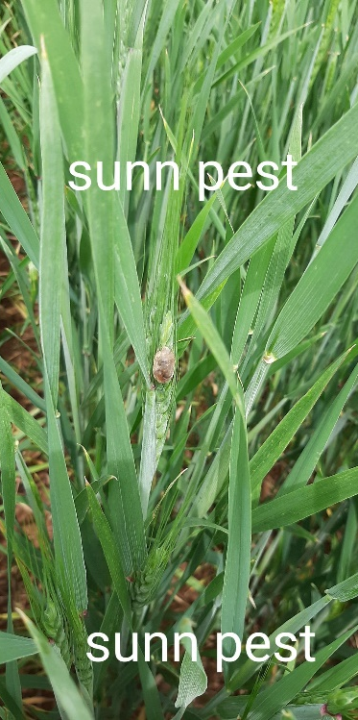
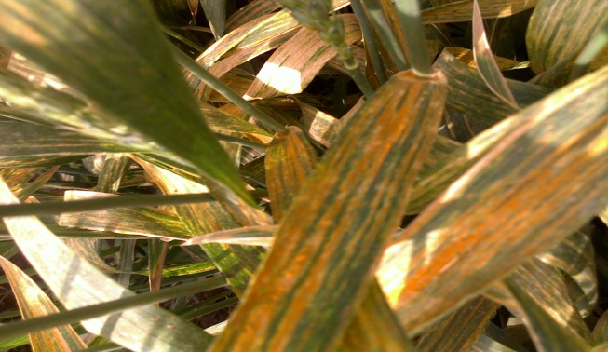
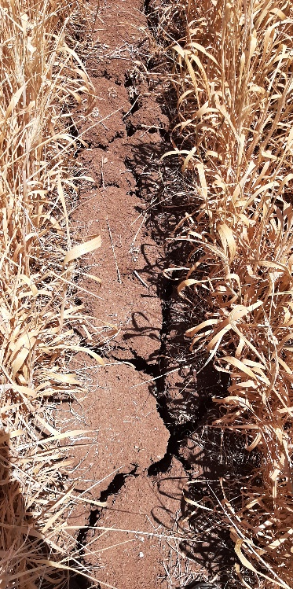
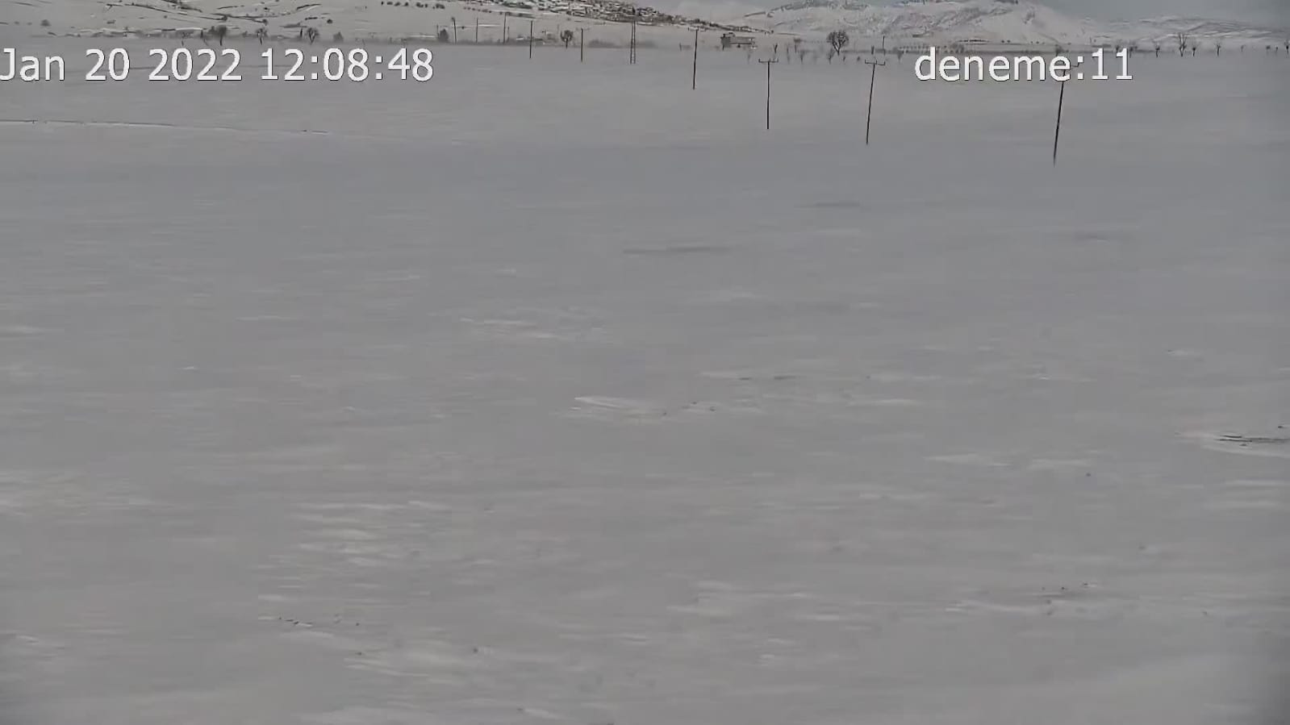
2. Experımental locatıons
Adıyaman: located about 100 km NW of Sanliurfa, old Husnumansur village of Olgunlar Seed Company ( 37,02-38,01 Northern latitude, 37,0-39,0 Eastern longitude)
om SL: 650 m
Annual rainfall (long term):668,5 mm
Annual rainfall for 2019-20 :891,3 mm
Annual rainfall for 2020-21: 530,0 mm
Annual rainfall for 2021-22: 373 mm
Major abiotic stress factors; some winter hardiness and moderate terminal drought and heat
Soil type: Loam, sandy

Slide 7
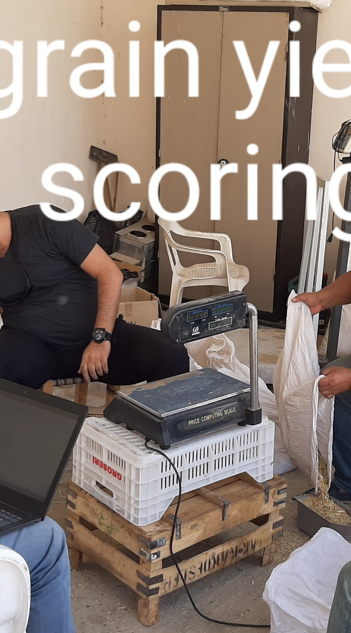
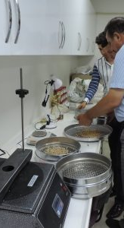
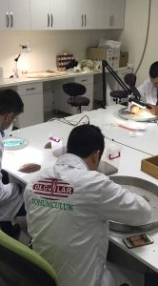
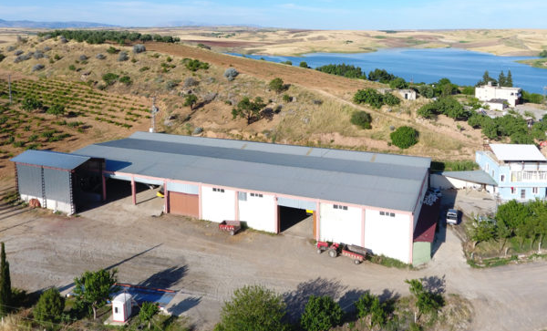
Olgunlar seed company
Family enterprise
25 years experience
2500 m² seed processing unit
18.000 tons annual seed production capacity
300 ha farming area
Variety improvement studies in major crops

Slide 8
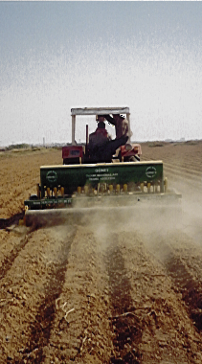
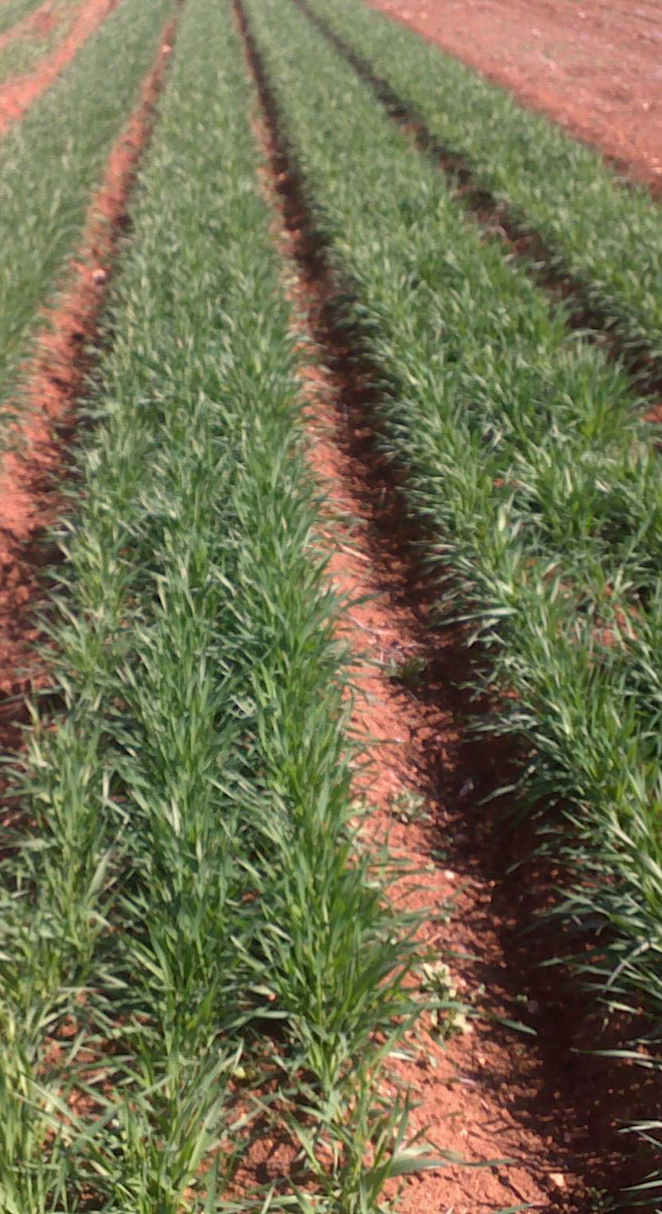
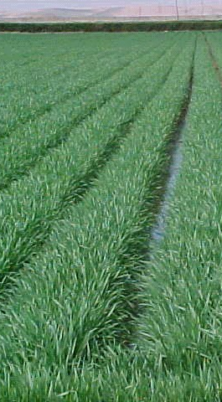
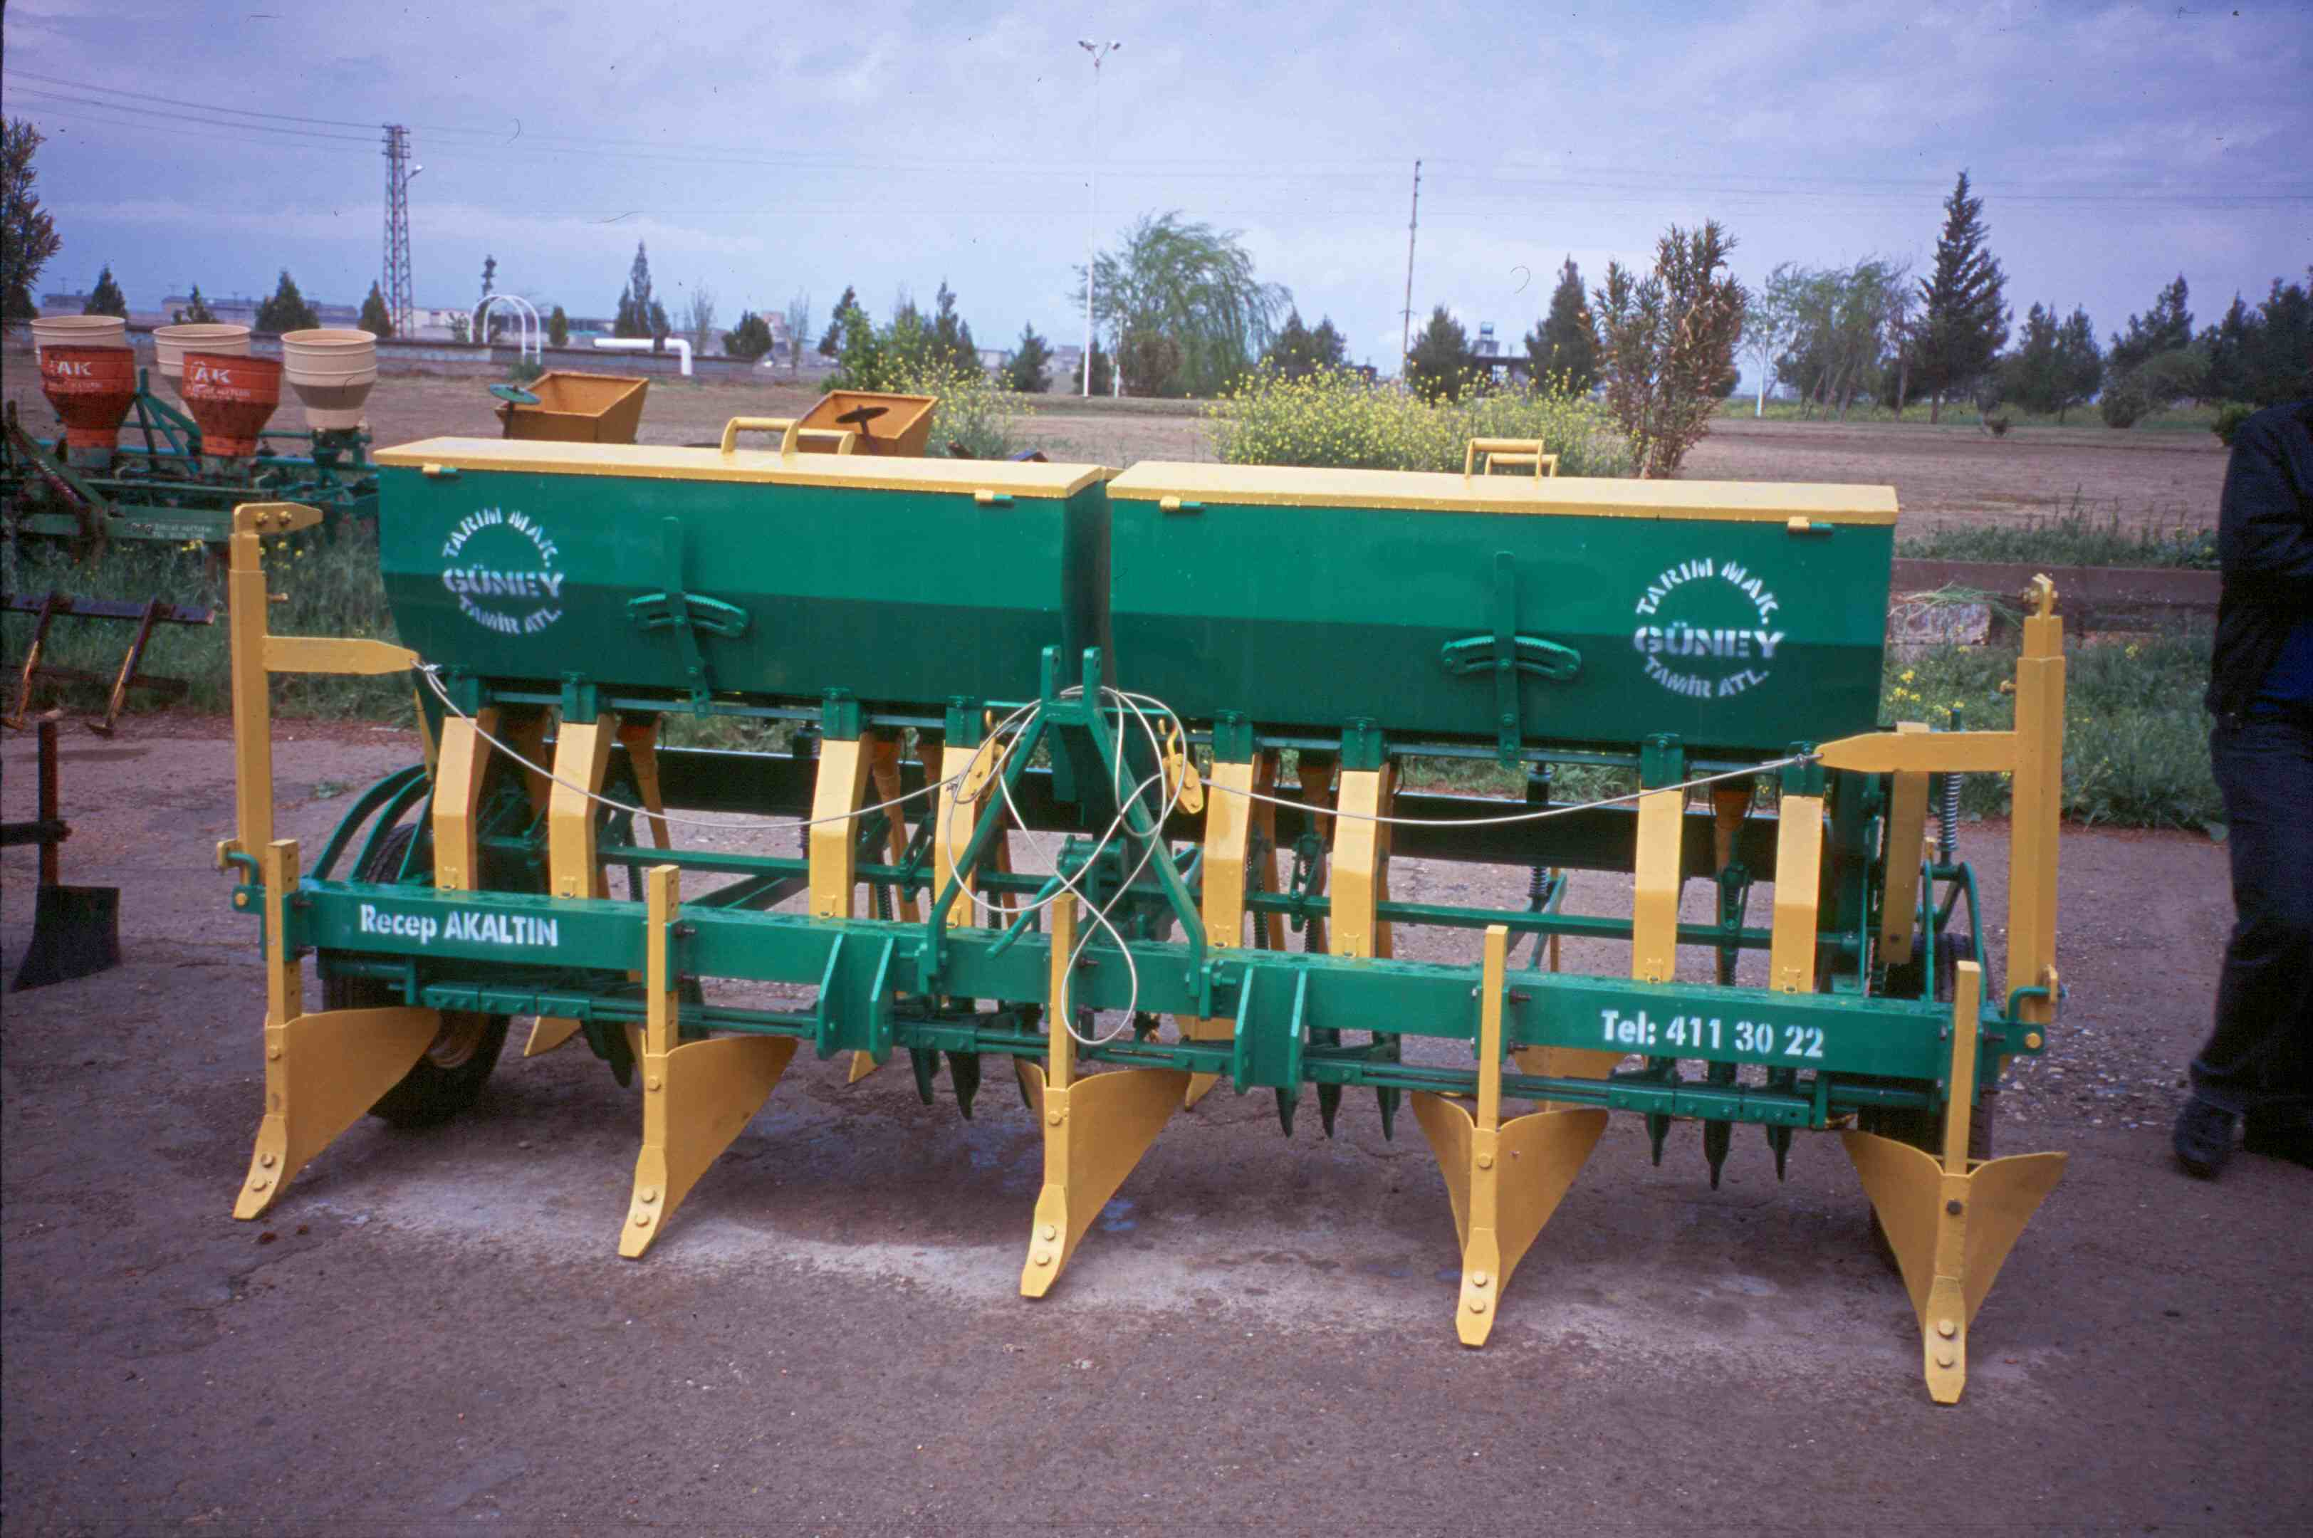
Bed plantıng and furrow ırrıgatıon
Ideal for Wheat+ II. crop corn
1/3 ınput save
Short turn around time
Easy irrigation management
Easy mechanical weed control

Slide 9
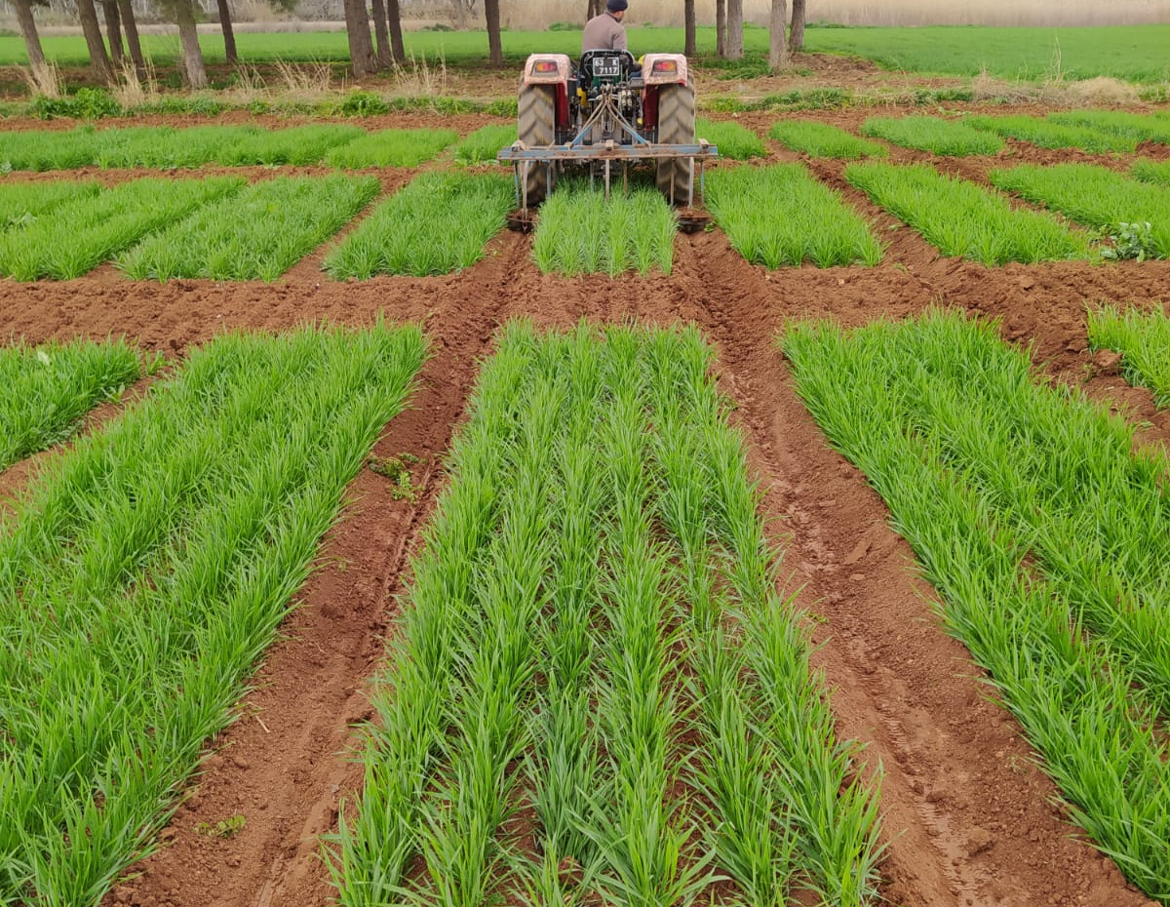
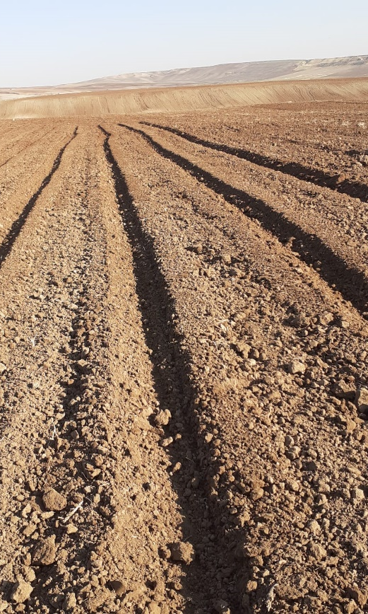
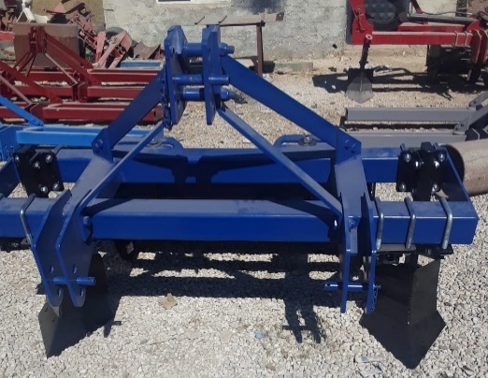
Bed plantıng and furrow ırrıgatıon
field trials in Koruklu: We planted first then built beds and furrows
In Adıyaman: we built bed and furrows first ,then sown

Slide 10
3. Evaluatıon of fıled nurserıes
Material list, tested;
Dryland observation nursery with 58 entries
(North African:10, Italian:14, Turkish: 17, DW-WWR:17)
2019-20:
Supp. İrrigation and dryland experiment in 2019-20 with 27 entries (17 Turkish+5 DW-WWR recom.+3 hom- +Simeto +Khiar)
2020-21:
Supp.irri. Experiment with 27 entries and dryland with 34 entries (27 shared + 7 varieties)
2021-22
Both dryland and supp.irri YT’s with 34 entries
Observation nursery with 58 entries

Slide 11
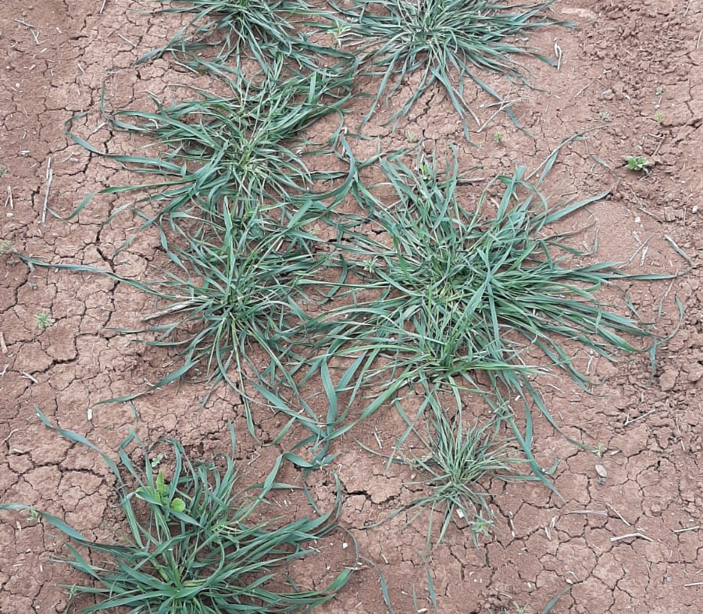
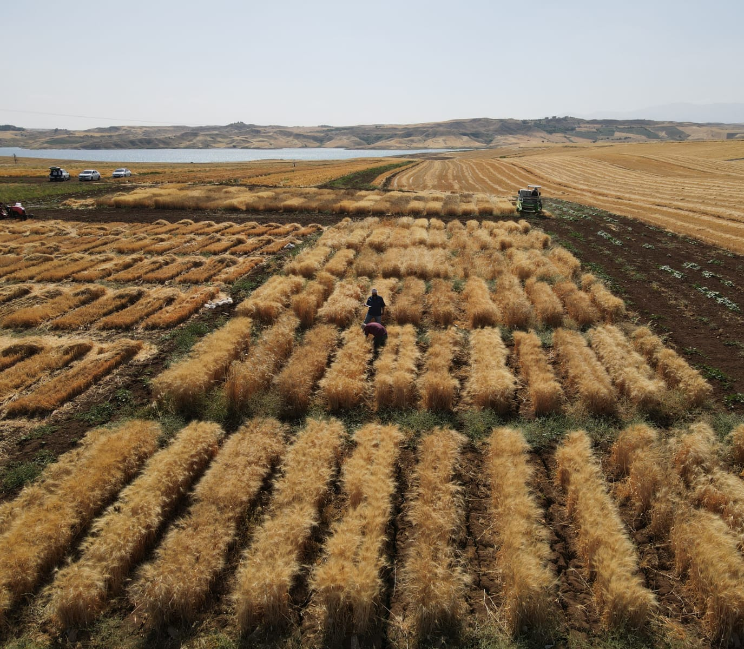
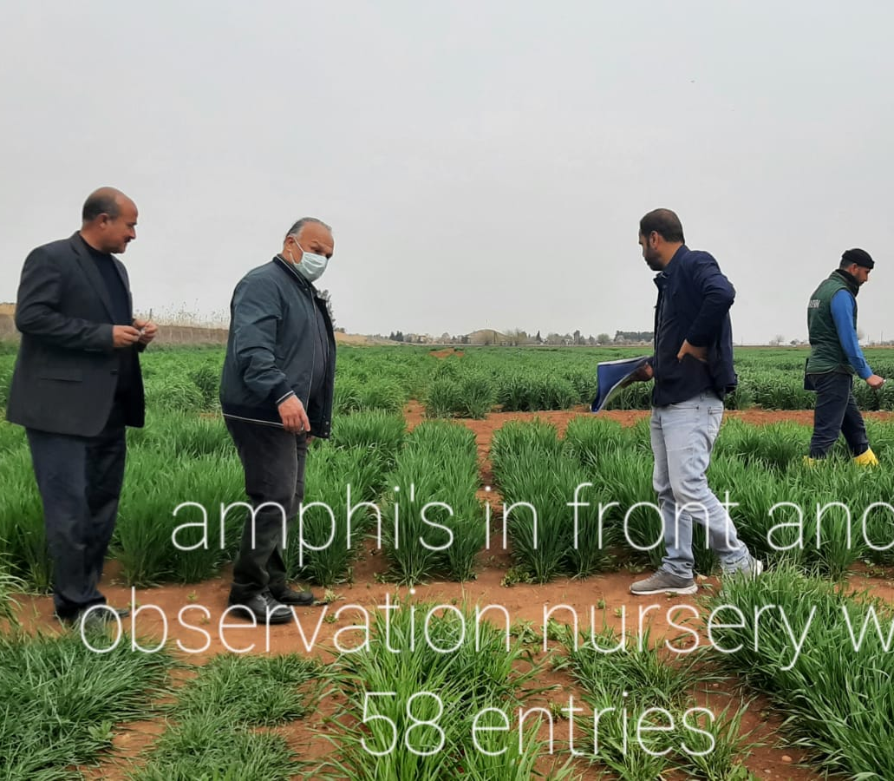
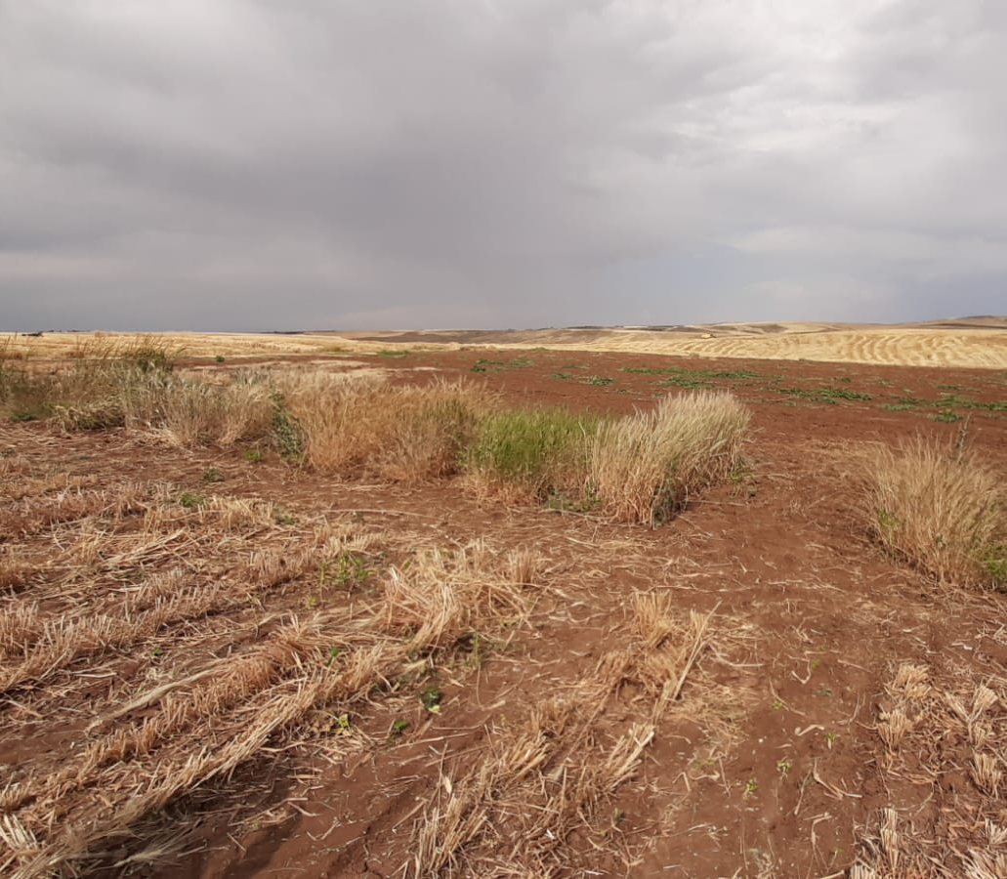
3.1 observatıon nurserıes

Slide 12
3.1. observatıon nurserıes
 | 2021-22 Adym |  | 2021-22Koruklu
Rank | Entry name/ origin | G.Yield g/ plot | Entry name/ origin | G.Yield g/ plot
1 | Antalis(2) | 2040 | R69.9..R5..hom+(3) | 1376
2 | Simeto | 1930 | R193/sim…hom-.(2) | 1338
3 | Ettore (3) | 1920 | R69.9.. R112….. hom-(3) | 1242
4 | Zühre | 1860 | Karim | 1220
5 | Sarıcanak-98 | 1800 | IDTY-22 (2) | 1200
6 | Rusticano | 1800 | R23 hom- | 1188
7 | Margherita | 1760 | RR68-6 | 1172
8 | Maali (2) | 1740 | Tüten-2002 | 1170
9 | R5 hom- | 1730 | R69-9.. R112… hom+(3) | 1158
10 | R112 hom+ | 1720 | Sarıcanak-98 | 1156

Slide 13
Promısıng and non adopted entrıes ın obser. Nursery for 3 years
Promising: Adıyaman: Antalis, Ettore, IDTY-22, Khiar, Monastir
Koruklu: IDYT-22, R69-9..R5….hom+, R69-9…R112..hom+, R69-9.. R112.. Hom-,

Slide 14
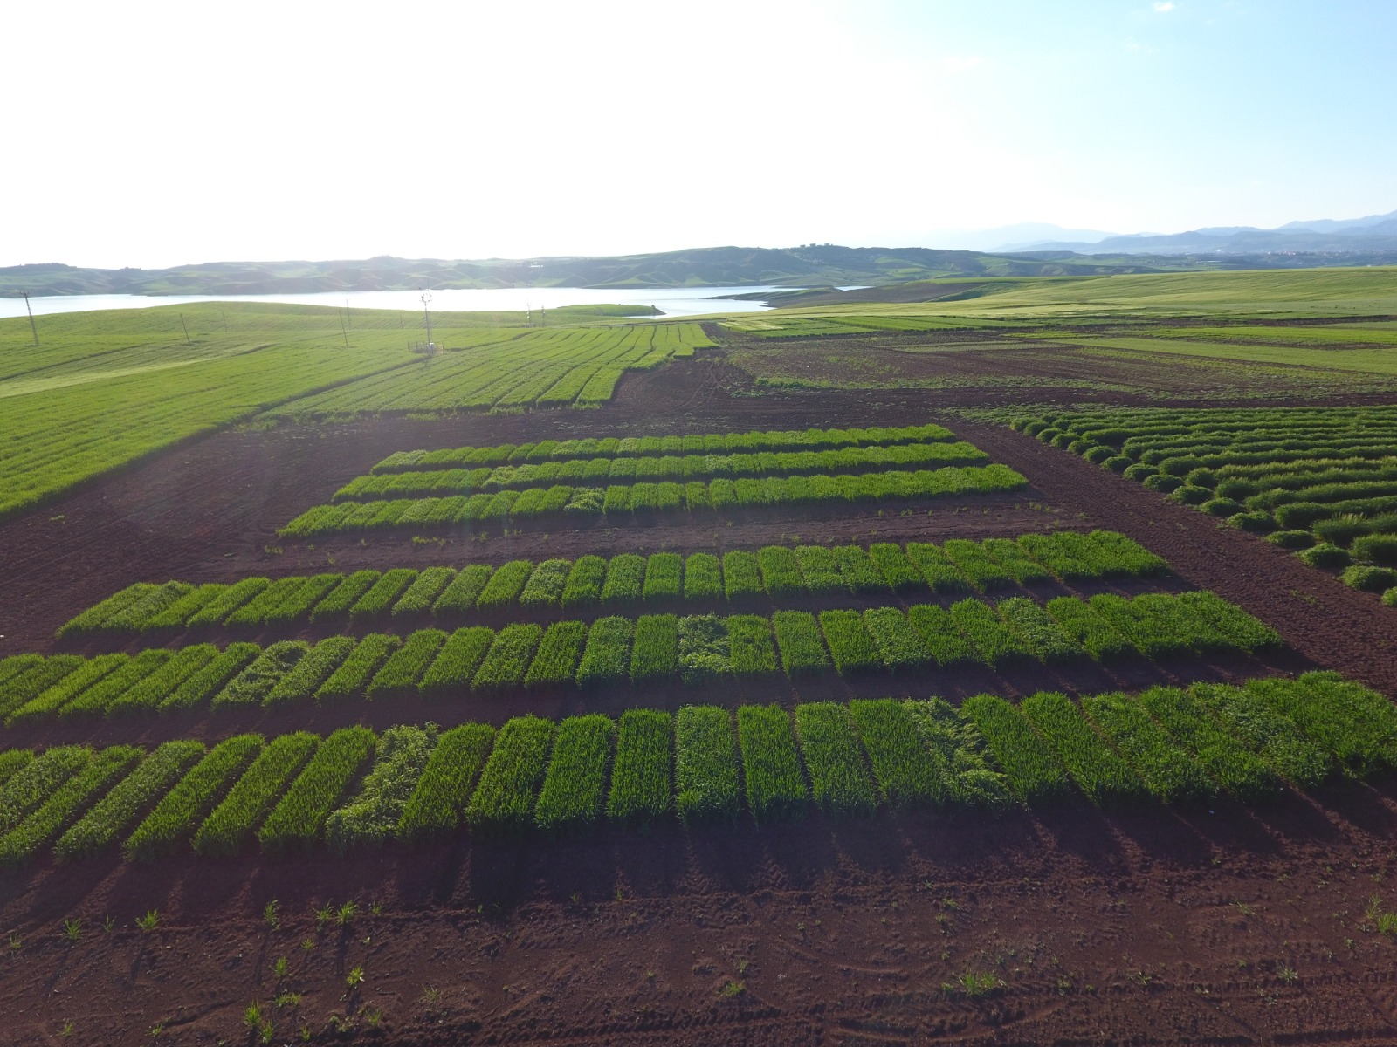
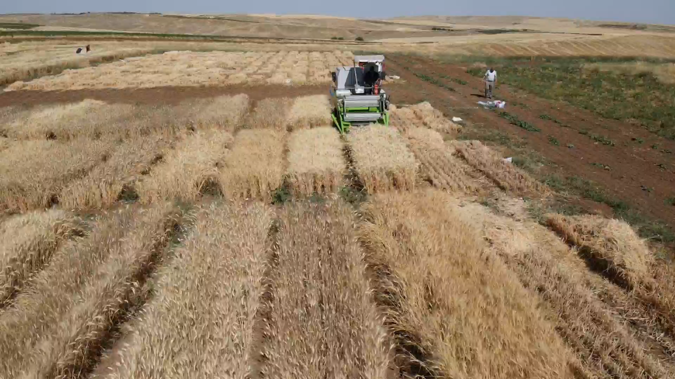
3.2 Evaluatıon of graın yıeld trıals

Slide 15
3.2 Evaluation of graın yield trials
In Adıyaman and Koruklu, 2021-22
Supp. irrigated yield trials: 34 entries, RCBD with 3 reps.
Dryland yield trials: 34 entries RCBD with 3 reps.
Plot size: 5 x1,2 m= 6 m²

Slide 16
2021-22 yıeld trıals
 | 2021-22 Adym(IR) |  | 2021-22 Koruklu (IR) |  | 2021-22 Adym (RF) |  | 2021-22 Koruklu (RF)
Rank | Entry name/ origin | G.Yield kg/ da | Entry name/ origin | G.Yield Kg/da | Entry name/ origin | G.Yield kg/da | Entry name/ origin | G.Yield kg/ da
1 | Zühre | 701 | Perre | 789 | R5 hom- | 631 | R23 hom- | 472
2 | Omrabia | 683 | Devedişi | 767 | Sarıbasak | 617 | R23 hom+ | 395
3 | Ayzer | 680 | Sümerli | 738 | Ayzer | 591 | Hacı Ali | 380
4 | Antalis | 669 | R5 hom- | 732 | Khiar | 590 | Özberk | 376
5 | Sarıcanak-98 | 668 | Ettore | 725 | Zühre | 582 | RR68-6. | 359
6 | Tüten-2002 | 666 | Artuklu | 722 | R5 Hom+ | 581 | Sümerli | 350
7 | Perre | 654 | Fırat-93 | 719 | R112 hom- | 572 | Devedişi | 336
8 | Nasr | 650 | SanCarlo | 718 | San carlo | 565 | R112 hom- | 329
9 | G.Yıldızı | 643 | Haciali | 716 | Omrabia | 556 | Artuklu | 322
10 | Sümerli | 630 | Antalis | 711 | Simeto | 551 | Antalis | 298

Slide 17
Better performing entries for both supp. ırrı. and Dryland conditions in 2021-22
Better performing entries for supp. İrri. condition in both location;
Perre, Sümerli and Antalis
Better performing entries under dryland condition in both locations;
R112 hom-

Slide 18
3.3. evaluatıon of Some of Qualıty traıts
Some of quality parameters scored at the Koruklu location for three years.
Hl weight, 1000 Kernel weight, Protein%, Semolina color and Sedimentation (mm) evaluated.
Means and groups for the first ten ranking entries were given for final year and testing conditions (supp. İrri/ dryland)

Slide 19
Hectolıter weıght
 | Supp. İrri. 2021-22 (34 entries) |  | Dryland 2021-22 (34 entries)
Rank | Entry no | Mean/ Groups | Entry no | Mean/ Groups
1 | 9 | 84,93a | 32 | 86,26a
2 | 22 | 84,67ab | 17 | 85,60ab
3 | 13 | 84,53abc | 23 | 85,46a-c
4 | 2 | 84,26abc | 2 | 85,33a-c
5 | 33 | 84,13a-d | 22 | 85,06a-d
6 | 24 | 84,13a-d | 24 | 84,93a-d
7 | 6 | 84,13a-d | 20 | 84,93a-d
8 | 32 | 84,00a-e | 7 | 84,53a-e
9 | 30 | 84,00a-e | 9 | 84,53a-e
10 | 28 | 84,00a-e | 5 | 84,40a-e

Slide 20
Better preformıng entrıes for Hectolıter weıght
Promising entries for Supp.irri for 3 years
Sarıçanak-98 (3), Alatay (3), Sümerli (2), Khiar(2),Özberk(2), Zühre(2), Edessa(2), Artuklu(2), Fırat-93 (2)
Promising entries for dryland for 3 years
Ettore(3), Alatay (3), Khiar(2), Perre (2), Fırat-93 (2), Sarıçanak-98 (2), Zühre (2)

Slide 21
1000 kernel weıghts (g)
 | Supp. İrri. 2021-22 (34 entries) |  | Dryland 2021-22 (34 entries)
Rank | Entry no | Mean/ Groups | Entry no | Mean/ Groups
1 | 14 | 50,13a | 26 | 53,33a
2 | 11 | 48,93ab | 30 | 51,06ab
3 | 12 | 48,26a-c | 13 | 49,06a-c
4 | 30 | 48,13a-d | 8 | 48,93a-d
5 | 8 | 47,33a-e | 15 | 48,66a-e
6 | 3 | 46,00a-f | 12 | 48,53a-f
7 | 10 | 44,80a-g | 19 | 48,26a-f
8 | 25 | 44,80a-g | 7 | 48,26a-f
9 | 7 | 44,29a-h | 9 | 47,46a-f
10 | 15 | 44,26a-h | 6 | 46,80a-g

Slide 22
Better performıng entrıes for 1000 kernel weıghts
Promising entries for supp.irri.for 3 years
R5 hom- (3), R5 hom+(3), Simeto(3), Fırat-93 (3), Özberk(3),r112 hom-(2), R112 hom+(2), Artuklu(2), Burgos (2)
Promising entries for Dryland for 3 years
Devedişi (3), R5 hom+(3), Özberk(3), R23 hom-(3), Fırat-93 (3), R112 hom+(2), Nasr (2)

Slide 23
Proteın(%)
 | Supp. İrri. 2021-22 (34 entries) |  | Dryland 2021-22 (34 entries)
Rank | Entry no | Mean/ Groups | Entry no | Mean/ Groups
1 | 7 | 14,40a | 25 | 18,70a
2 | 15 | 14,06ab | 13 | 18,63ab
3 | 16 | 13,76a-c | 27 | 18,43a-c
4 | 3 | 13,66a-d | 11 | 18,30a-d
5 | 12 | 13,23b-e | 14 | 18,13a-e
6 | 22 | 13,16b-e | 28 | 18,10a-e
7 | 32 | 13,13c-e | 6 | 17,83a-f
8 | 28 | 13,13c-e | 26 | 17,70a-g
9 | 27 | 13,13c-e | 15 | 17,70a-g
10 | 21 | 13,13c-e | 12 | 17,60a-g

Slide 24
Better performıng entrıes for proteın %
Supp.irri for 3 years:
R112 hom+(3), Hacıali (3),Fırat-93(2), Özberk(2), Simeto(2), Alatay(2), RRR55-2(2)
Dryland for 3 years;
Sümerli(3), Hacıali(3), G.Yıldızı(3), Burgos (2), Devedişi(2)

Slide 25
Semolına color
 | Supp. İrri. 2021-22 (34 entries) |  | Dryland 2021-22 (34 entries)
Rank | Entry no | Mean/ Groups | Entry no | Mean/ Groups
1 | 16 | 34,53a | 16 | 32,35a
2 | 12 | 32,43ab | 8 | 31,29ab
3 | 4 | 31,65a-c | 21 | 30,41a-c
4 | 32 | 31,47b-d | 30 | 29,80a-d
5 | 6 | 30,99b-e | 12 | 29,53a-e
6 | 13 | 30,66b-f | 4 | 29,50a-e
7 | 21 | 30,47b-g | 13 | 29,16a-e
8 | 8 | 29,95b-h | 28 | 29,13a-e
9 | 22 | 28,73c-ı | 19 | 28,67a-f
10 | 11 | 28,72c-ı | 6 | 28,63a-f

Slide 26
Better performıng entrıes for semolına color
For supp.irri for 3 years
R112 hom+ (3), Ayzer(3), G.Yıldızı(3), Sümerli(3),RRR55-2 (3), R5 hom+(3), R5 hom-(2), R23 hom+(2)
For dryland for 3 years
R23 hom+(3), R5 hom+(3), RRR55-2 (3), R112 hom+(3), Ayzer (3), Sümerli (3), G.Yıldızı(3)

Slide 27
Sedımantatıon (mm)
 | Supp. İrri. 2021-22 (34 entries) |  | Dryland 2021-22 (34 entries)
Rank | Entry no | Mean/ Groups | Entry no | Mean/ Groups
1 | 16 | 16,67a | 13 | 25,50a
2 | 2 | 16,33ab | 33 | 25,17a
3 | 3 | 15,00a-c | 11 | 25,17a
4 | 34 | 14,00a-d | 17 | 24,84ab
5 | 26 | 14,00a-d | 34 | 24,17a
6 | 32 | 13,66a-d | 22 | 23,84ab
7 | 6 | 13,66a-d | 18 | 23,84ab
8 | 8 | 13,66a-d | 30 | 23,84ab
9 | 15 | 13,33a-d | 7 | 23,17ab
10 | 24 | 13,00a-d | 15 | 23,17ab

Slide 28
Better performıng entrıes for sedımEntatıon
Supp.irri.for 3 years
Simeto(3), G.Yıldızı (3), R5 hom+(3), Perre
Dryland for 2 years
R112 hom-(2), Hacıali (2), Perre (2), R 112 hom+(2), Simeto (2), R5 hom-(2), Monastir(2), San Carlo (2)

Slide 29
EARLY RESULTS FROM YIELD TRIALS OF 2021-22
Better performing entries for supp. İrri. condition in both location;
Perre, Sümerli and Antalis
Better performing entries under dryland condition in both locations;
R112 hom-
R23 Hom+, R23 Hom- only in Koruklu
R5 hom+ ve R5 hom+ only in Adym.
Quality:

Slide 30
ObservatIon nursery for 3 years
First ten ranking entries performing rank- sum analysis for all traits under study;
Khiar , R193/Simeto/IDYT22 HOM-, Margherita, Ettore, Antalis, IDYT 22, Achille, Simeto, Rusticano and Omrabia

Slide 31
Yıeld trıals for 3 years
First ten ranking entries employing rank sum analysis for all traits under study;
Both under SI + rainfed; R5 Hom-, R5 Hom+, R112 Hom- ,R112 Hom+ , Sümerli ve Alatay
Only SI: Ayzer, Tüten -2002 ,Perre ve Burgos
Only RF; Simeto, Sarıçanak-98, Edessa ve RRR55-2

Slide 32
2022-23 actıvıtıes
Yield trial (out of Project)
In Adıyaman;
Supp.irri with 25entries, RCBD with 3 reps (plot size 5m x 6 rows= 6 m²).
F2 bulk segregating material
F1 in Koruklu

Slide 33
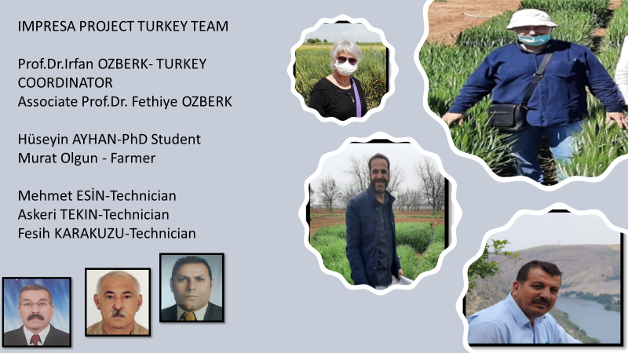

Thanks for your great efforts

