Slide 1
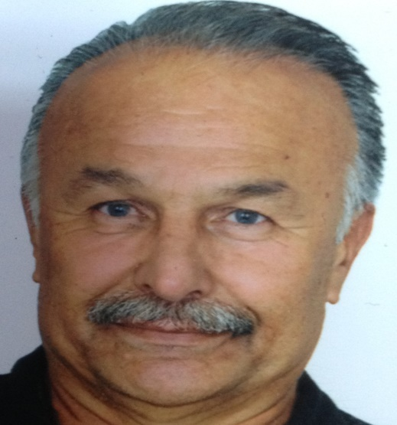

Profesor (catedrático?) Dr. İrfan Özberk,
Nació en la ciudad de Nazilli de Turquía en 1958
Ensambló la facultad agrícola de Universidad de Ege en 1976 y graduó en 1981.
Trabajó en el Instituto agrícola del sureste de Anatolia en 1986.
Fue a México para los 8,5 meses de entrenamiento en "mejora del trigo" en 1987.
Hizo un Máster sobre la «mejoramiento de planta y la mejora de la cosecha" en la Universidad de Birmingham y la Universidad de la Reading a partir de 1990 a 1992.
Se graduó doctor (PhD) en el departamento del Cultivo Herbáceos de la Facultad de Agricultura en 1997.
Ha desarrollado (en común) 13 variedades de trigo duro, 2 variedades de trigo harinero y 2 de cebada .
Después trabajó en la Facultad de Agricultura en la Universidad de Harran en 2000.
Calificado para el professorship de Assoc. en 2006
Es profesor (catedrático?) desde 2012.

Slide 2
Variedades locales de trigo en Mesopotamia
Prof.Dr. İrfan ÖZBERK
Dept.Planta del Campo
Universitad de Harran
Şanlıurfa, Turqia

Slide 3
Wheat landraces in Mesopotamia
Prof.Dr. İrfan ÖZBERK
Dept. Of Field Crops
Fac. Of Agri. The Univ. Of Harran
Şanlıurfa

Slide 4
Disposition / disposición
1.Historical background / Antecedentes históricos
2. Landraces and characteristics / Variedades locales y características
3. Current situation / situación actual
4. Future trends / Futuras tendencias

Slide 5
Historical background/Antecedentes históricos
Let’s start with the origin of cultivated crops
Vavilov (1935), in his book named phytogeographic base of plant breeding
Origin of wheat, Fertile Crescent
SE Anatolia at the northern part of that area

Slide 6
Wheat species in Turkey / Especies de trigo en Turquía
Species | Ploidy level | Number of species + cultivated
Triticum/Aegilops | diploid | 9+1
Triticum/Aegilops | tetraploid | 12+1
Aegilops | hexaploid | 4+1
Total |  | 25+3

Slide 7
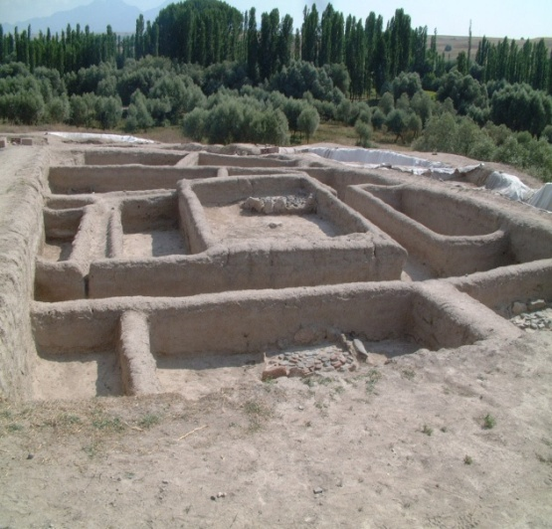
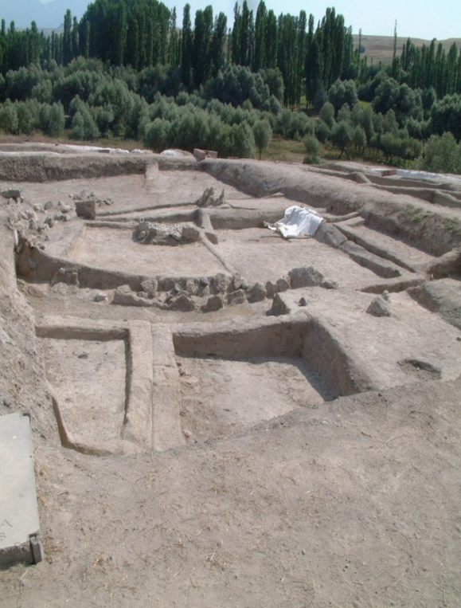
Plant remnants found in excavations in Turkey
Restos de plantas en excavaciones en Turquía
Approx. Date (BC) | Location | Plant remnants
7500 | Aşıklı Höyük | Einkorn, emmer ,durum wheat, barley, lentil, wild wetch, peas, chickpeas
7200–6500 | Çayönü | Wild einkorn and emmer and barley; cultivated einkorn and emmer,
6750 | Hacılar | Wild einkorn, cultivated emmer
6500 | Can Hasan | Wild einkorn, cultivated einkorn, emmer, wheat, barley (2 row), lentil
6000–5000 | Çatal Höyük | Cultivated einkorn, emmer, wheat, barley (naked), peas, vetch
6000–5000 | Erbaba | Cultivated einkorn, emmer, wheat, barley (2 rows and naked), peas, lentil, vetch
Aşıklı Höyük
(Aksaray)

Slide 8
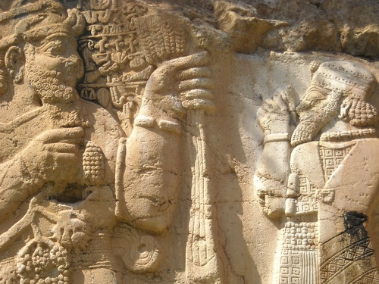
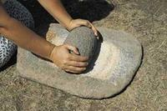
Konya Ereğli, İvriz, BC 750, King Tarhundas, Frigya

Slide 9
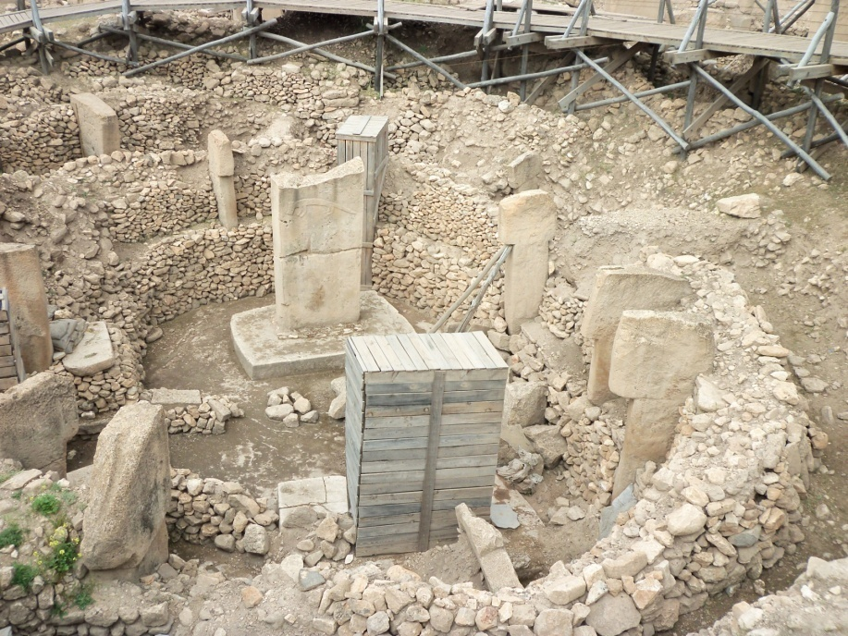
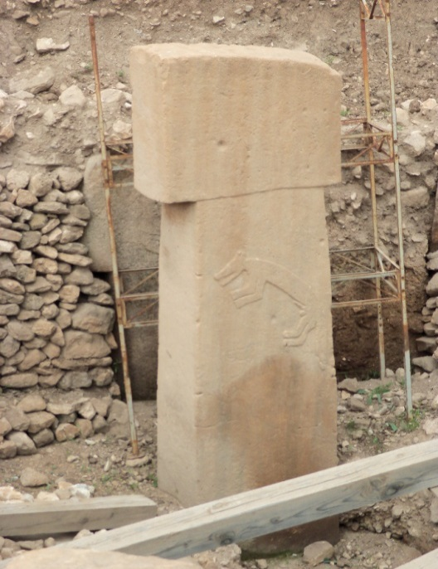
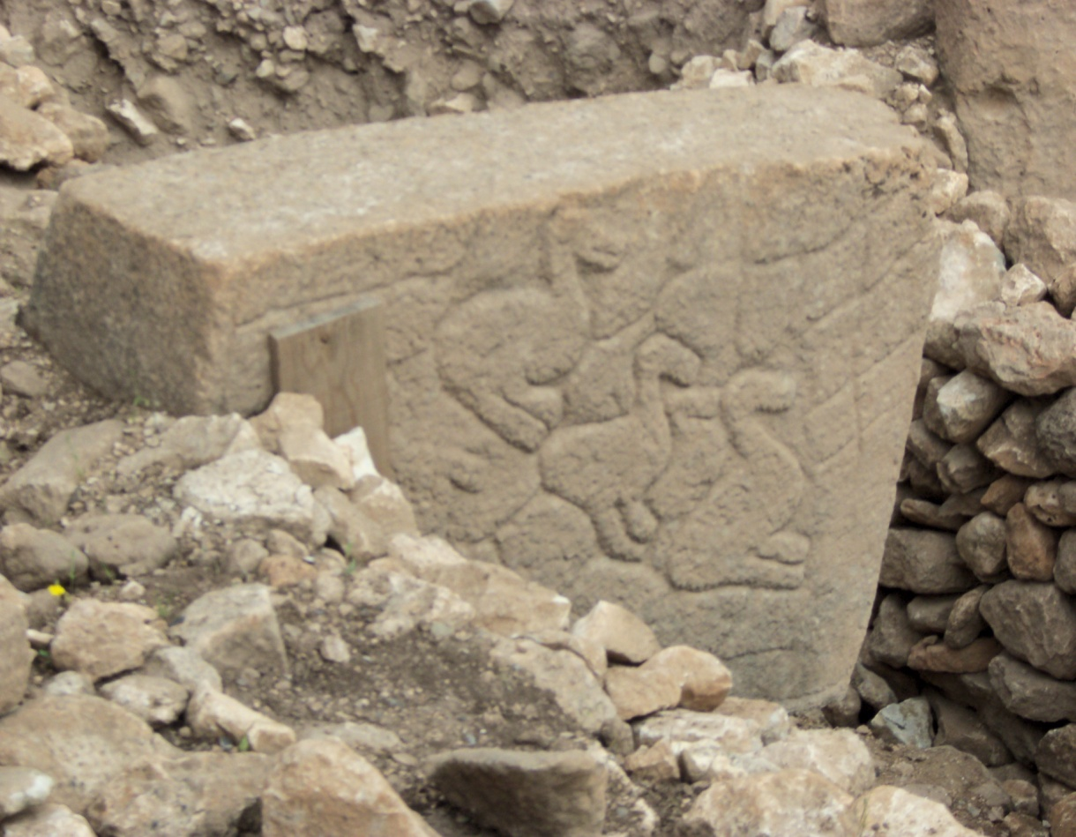
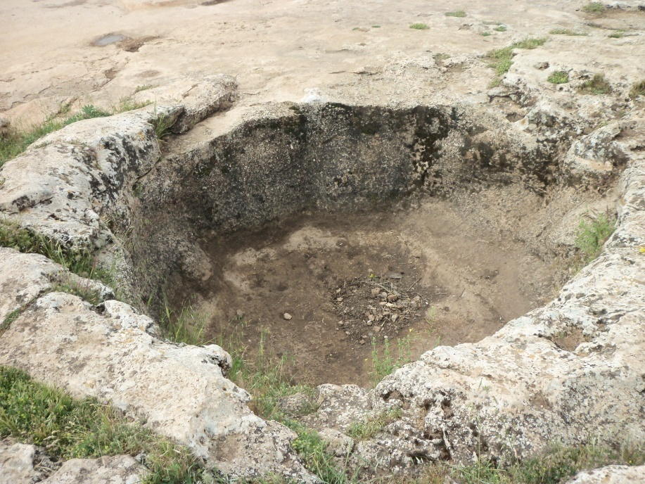
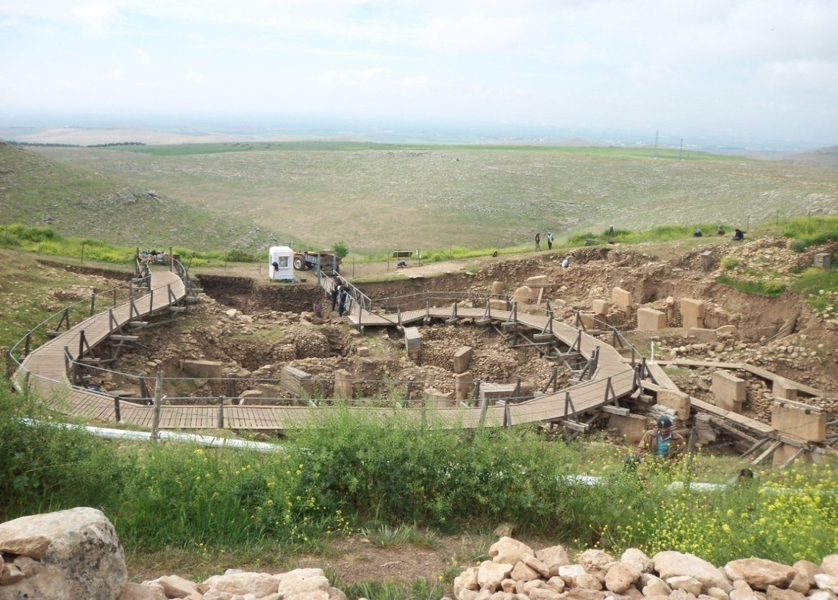
Göbekli Tepe
Şanlıurfa

Slide 10
Historical background/Antecedentes históricos
Çayönü and Jarmo excavations: Agricultural emergence first started in the Fertile Crescent (Braidwood and Breadwood,1950, Harlan,1981)
Where is the Fertile Crescent (FC)??
Hilly area between Euphrates and Tigris until Jordan (Terence ve ark.,2008).
FC first used by James Henry Breasted (1938) (Braidwood, 1972).

Slide 11
Karacadağ’da Yaygın yabani siyez popülasyonu . Foto: H.Özkan July 2004

Slide 12
Historical background/Antecedentes históricos
Archeological excavations claim;
Agriculture first emerged: Göbekli Tepe 11,000 years ago (Bird,1999)
Radiocarbon analysis indicated that agriculture started 9,000-12,000 years ago
(Zohary ve Hopf; 2000; Nesbitt, 2002; Salamini ve ark., 2002; Hillman, 2000)

Slide 13
Historical background/Antecedentes históricos
Last 20 years, studies with molecular markers (AFLP)
Nearest form of cultivated einkorn found in Karacadag
(Heun et al.,1997;Diamond,2002; Mori ve ark., 2003; Özkan ve ark., 2002; Luo ve ark., 2007;Killian ve ark.,2007)
The origin of 8 crops FC,
3 of them temperate cereals; einkorn (T.monococcum), emmer (T. dicoccum ) and barley (H. vulgare) (Terence ve ark., 2008).

Slide 14
Difference between wild and cultivated einkorn/ Diferencias entre la escaña silvestre y la cultivada (Fig: S. Killian)

Slide 15
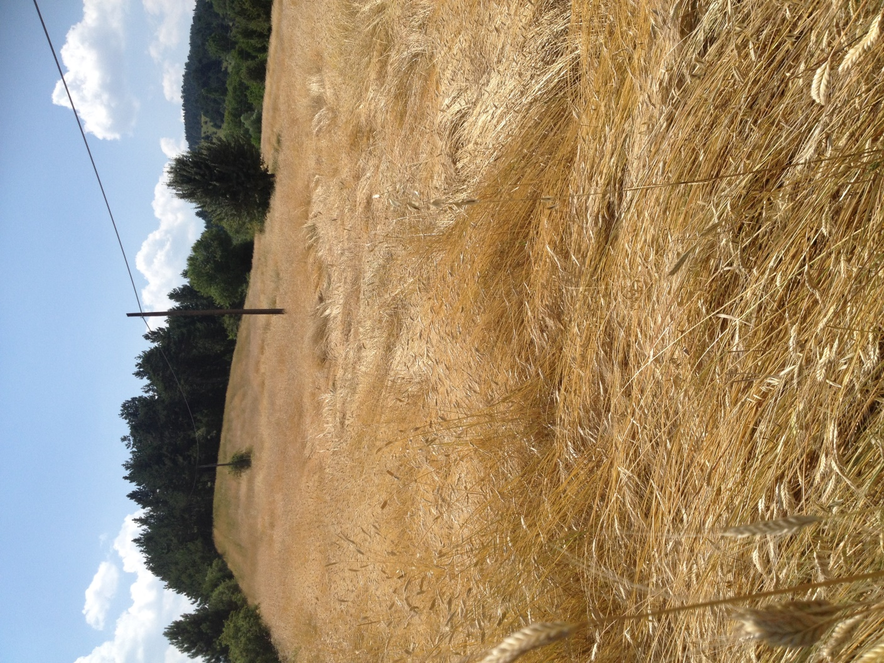
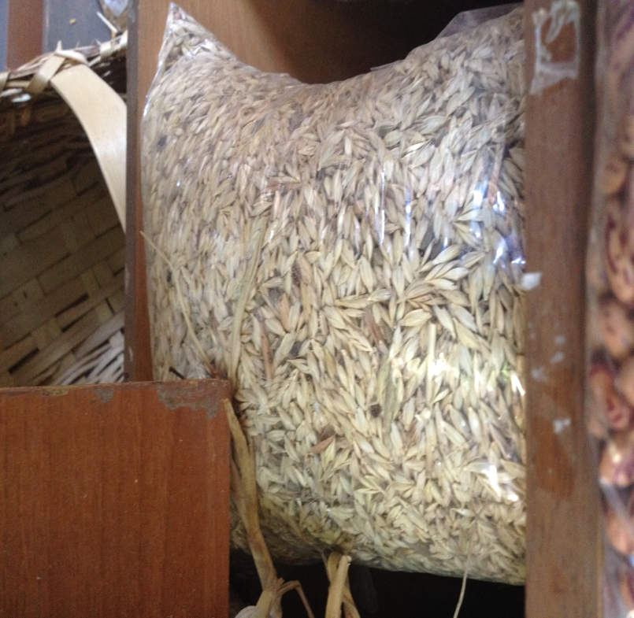
Siyez (einkorn, escaña)
Hulled and tall, lodging type

Slide 16
Historical background / Antecedentes históricos (domestication evidences / evidencias de domesticación )
1. No shedding for both grain and spikelets
2. Less hair, hooks and awn in grain
3. Increased kernel size
4. Less sensitivity to day length and temperature in germination and flowering
5. Increased homogeneity in tillering and maturity,

Slide 17
Historical background / Antecedentes históricos
6. Increased plant homogeneity based on selection of compact growing habit plants
7. Increased suitability for bread making (Hammer,1984; Brown,1999; Salamini ve ark.,2002; Terence ve ark.,2008; Killian ve ark.,2009).

Slide 18
Spike forms of Aegilops and Triticum species during the course of domestication /Formas de espiga de Aegilops y Triticum durante evolución

Slide 19
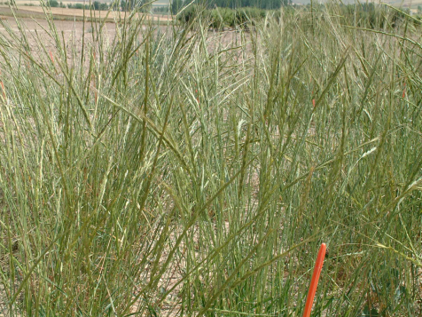
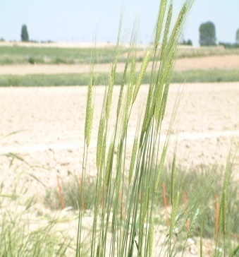
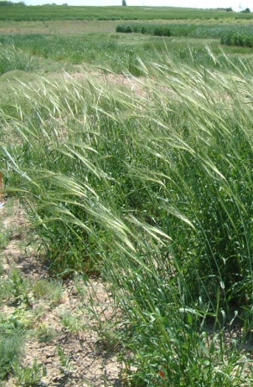
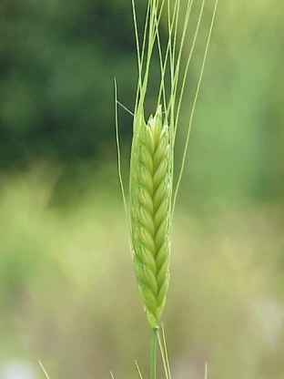
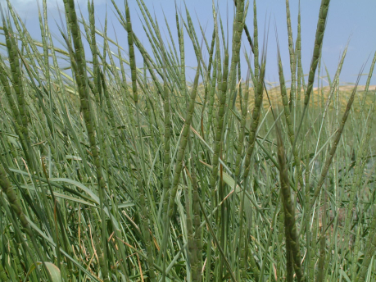
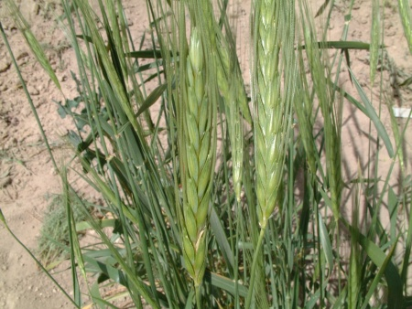
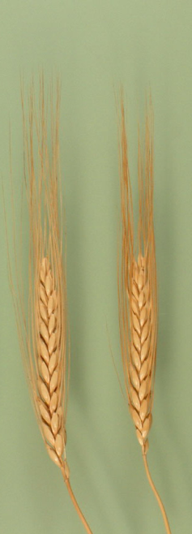
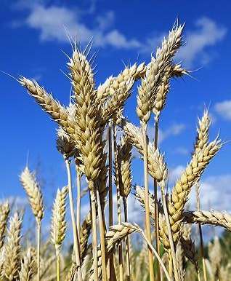
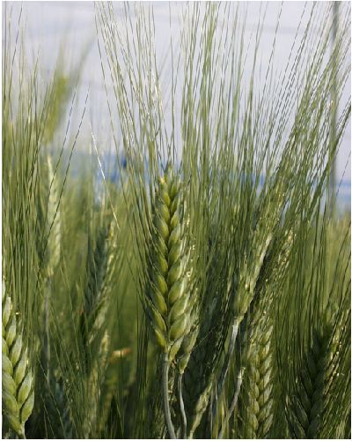
Evolution of wheat/ Evolución del trigo
X
T. urartu
Ae. speltoides
T. boeoticum
T. monococcum
AA
BB
X
Ae. tauschii
T. dicoccoides
DD
AABB
T. dicoccon
T. aestivum
T. durum
AABBDD
AABB

Slide 20
Historical background/Antecedentes históricos
Definition of a landrace / definición de variedad local:
historical background
not developed by modern plant breeding methods- presence of unique characteristics
not genetically homogeneous
limited yielding
usually suitable for self sufficient farming-local adaptation
suitable for local dishes
dynamic population structure
(Zeven,1999; Camacho Villa et al. 2006; Özberk, 2018 ).

Slide 21
Historical background / Antecedentes históricos
In evolutional period ;
Many landraces derived - genetically heterogeneous - suitable for semi dryland conditions (Jaradat, 1992; Brown, 2000)
Unique traits of landraces;
Growing habit-tolerance to cold and drought-early vigor-heading and maturity periods- grain filling period and some quality traits
(Masood ve ark., 2005)

Slide 22
Historical background/Antecedentes históricos What is their names?/ ¿Cómo se llaman?
Morphological structure
Spike lenght, shape, awn and spike color (karakılçık), awn/ awnedless (köse),grain color (kızılca), grain plumpness, grain hardness
Geographical location (Havrani)
Growing habit : spring or winter type
Due to the name of seed holder: Hacı halil gibi,
Suitability for end product: Aşure

Slide 23
Disposition / disposición
1.Historical background / Antecedentes históricos
2.Landraces and characteristics / Variedades locales y características
3. Current situation / situación actual
4. Future trends / Futuras tendencias

Slide 24
Characteristics of landraces / características de variedades locales de trigo
Compare to modern varieties;
Higher biological yield, higher transpiration rate, lower root dry weight,
Higher carbonhydrate concentration results in
early maturity (Jaradat, 2012)
Lower grain yielding,
Escapes from drought (Ayed ve ark.,2010)

Slide 25
Characteristics of a landrace / Características de variedades locales de trigo
Compare to modern V/s;
Generally alternative growing habit
Lower harvest index.
Adaptation to lower nitrogen rate (Genç ve ark.,2005),
Higher for micronutrient content (Cu, Fe, Mg, Mn, P, Se, Zn)

Slide 26
Characteristics of land race in SE Anatolia / Características variedades locales de trigo en Sureste Anatolia
Various researchers revealed;
Lodging type
Less response to chemical fertilizer
Non suitability for combine harvesting
Susceptible to major foliar diseases
But;
Good adaptation, ability to stand adverse conditions
Good grain quality
Generally plumb grain

Slide 27
Characteristics of landrace in SE Anatolia / Características variedades locales de trigo en Sureste Anatolia
Stalk and hay palatable for animals
Suitable for self sufficient farming sys.
Tolerance to cold, heat and drought
High water and nutrient use efficiency,
(Zeven,1998; Harlan,1981, Kebebew ve ark.,2001; Camacho Villa ve Ark.,2006)

Slide 28

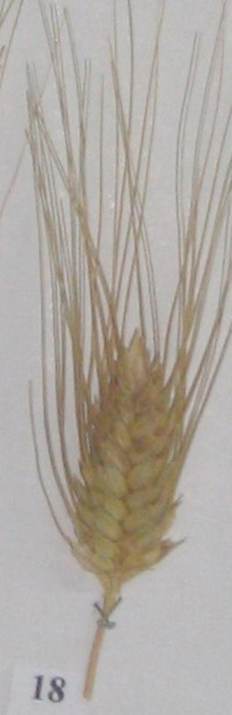
SE Anatolia Landraces
Sorgül
(1897-1982)
Gökgöl ve ark. (1935-39) under 400 local names 256 new morphotype detected.
Diyarbakır;
Abuzer,Beyaz, Devedişi, Geore, Humrik, İskenderi, Karakılçık, Kırmızı, Kışlık beyaz, kışlık büyükbaş, komoy-karakılçık, memeli, Pırçıklı sorgül, Ruto=Köse, Sorgül, Yazlık, Yazlık beyaz, Yazlık kırmızı, Yusufi

Slide 29
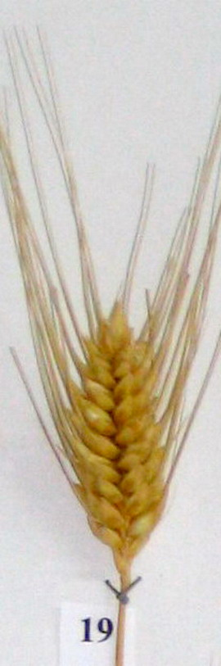
Landraces in SE Anatolia
Havrani
Şanlıurfa: Ak Şami, Berzinnar, Beşiri (Bişeri), Beyaz, Beyaz sert, Beyaz topbaş, Beyaz yumuşak,
Beyaziye, Birecik, Bozova, Havrani, İskenderiye (İskenderi),
Karakılçık, Kendehari beyaz, Kendehari kırmızı, Kırmızı buğday, Kırmızı Havran,Kırmızı kara, Kırmızı menceki, Kırmızı mısri, Menceki, Mestişani, Mısri,
Niseyri (Nuseyri),Samsai, Siri seyhan, Şami, Ufak daneli, Yazlık kendehari, Yerli karakılçık, Yusufi (Gökgöl,1939)
Bağacak

Slide 30
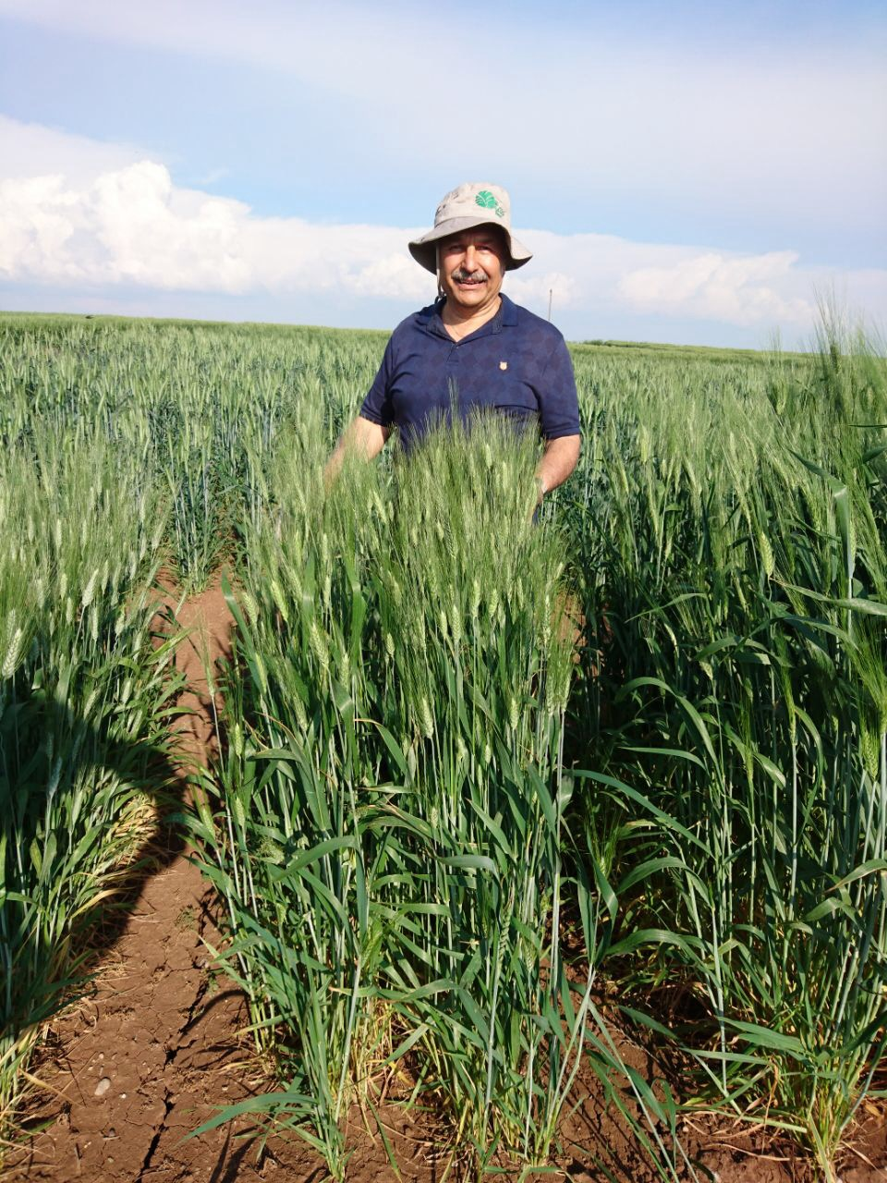
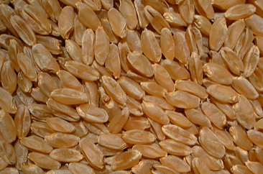
Haurani, local durum wheat landrace / variedad local de trigo duro

Slide 31
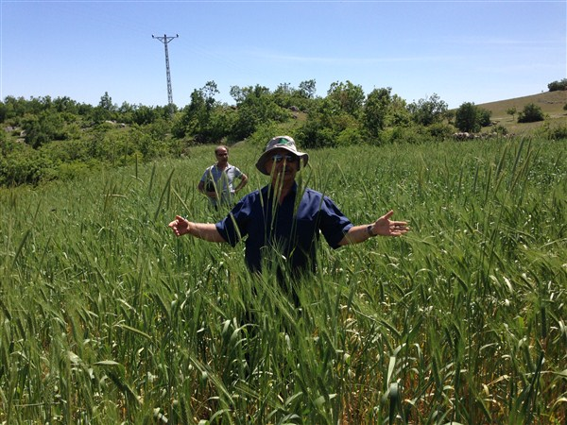
Devedişi-Gerger, Adıyaman

Slide 32
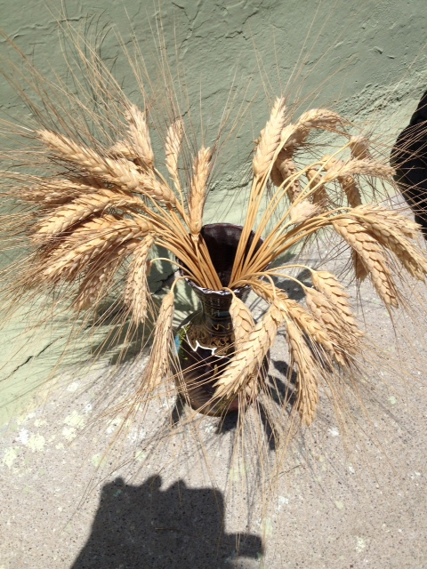
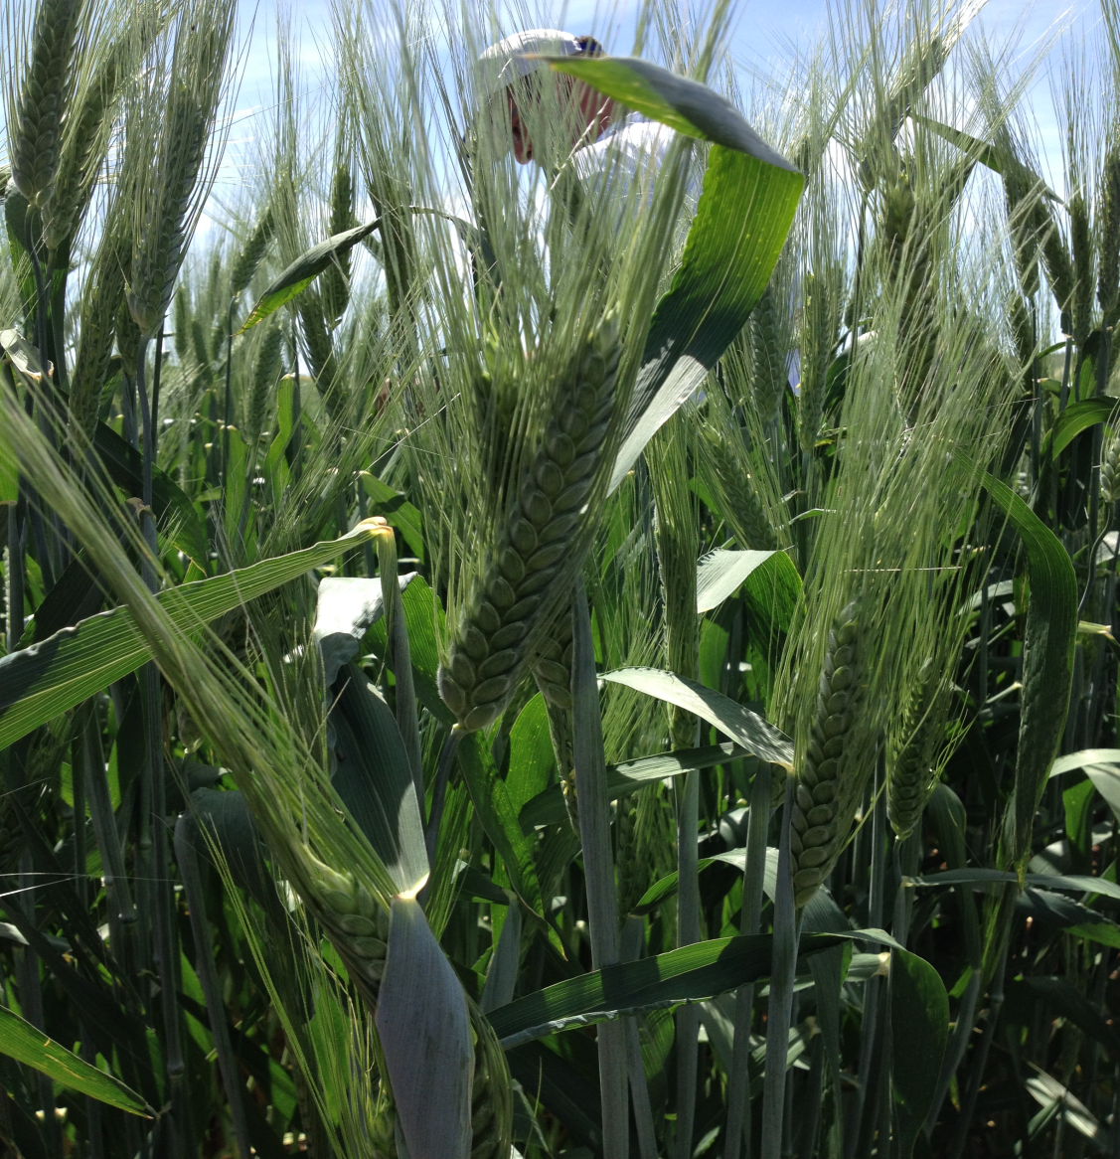
Devedişi (=camel tooth)/ otra variedad de local (diente de camello)

Slide 33
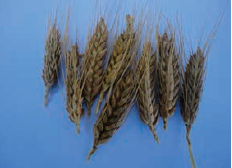
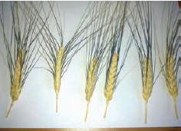
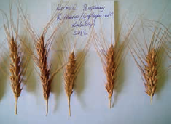
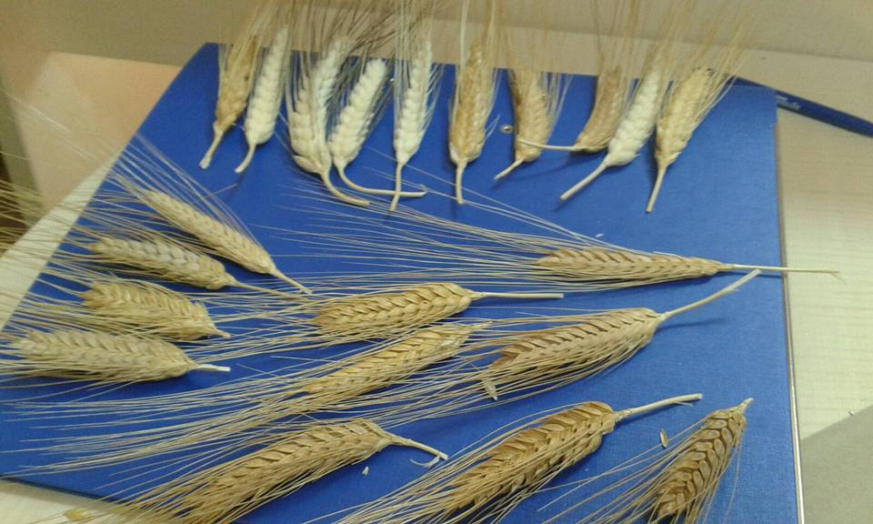
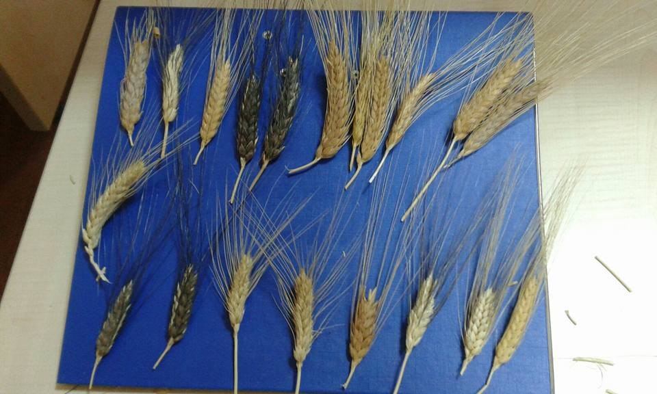
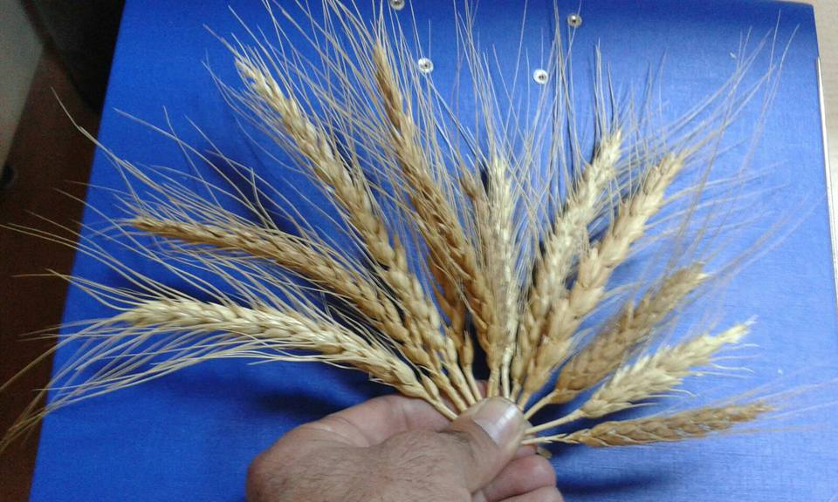
TOPBAŞ
KARAKILÇIK
KIRMIZI BUĞDAY (SORIK)
SORGUL-HAVRANİ- BEYAZİ
BEJİREŞ-BEJİSOR- SORIK-HİNTA
EKMEKLİK YEREL ÇEŞ

Slide 34
SE Anatolia land races, contribution to World wheat / Contribución de trigo al mundo (Özberk ve ark.2016, Aktaş ve ark.,2017)
Red Turkey: Mennonites in Crimea in 1873 moved to USA with it. Grand pa. of US hard red winter wheat (Braun et al., 2001).
Manitoba (USA) and Saragolla (Italia) are varieties of Turkey origin (Gökgöl, 1935),
Hakkari (Şemdinli) origin, spring type durum ‘Horanek’
Dominated Russian varieties; early maturing ability, heat tolerance, high yielding, tolerance to fusarium and hessian fly (Zhukowsky,1951)

Slide 35
SE Anatolia landraces, contribution to World wheat / Contribución de trigo del SE de Turquía al mundo (Özberk ve ark., 2016, Aktaş ve ark.,2017; Lopez ve ark.,2015)
Harlan mission (1949-64)
2,121 accessions from Şemdinli’ collection;
Entry no: PI178383
At the shelf of gene banks for years, then under yellow rust epidemy
Re-employed, found tolerance to 51 races of yellow rust and some other diseases.
USA made huge money from this line (Qualset, 1996).

Slide 36
Syrian landrace groups ( DW)
149 populations (Van Slageren ve ark.,1989)
Swehidi, Sheirieh, Shihani, Haurani, Baladi, Hamari, Bayadi (Elings,1993)
Nab El jamal, Yabroudi,Jidouri, Zedi, Gharbi Joulani, Jabali, Siklawi (Syrian Country Report)

Slide 37
Syrian landraces
Shyhani, Sawadi, Abosadi, Hriadia
Jazeraa 17,Joury, Hamary, Haurany, Ayoubeeh, Bayady
Salamony (BW) (Sahoib ve Arabi, 2006)

Slide 38
Characteristics of Syrian landraces / Características variedades locales sirias de trigo
38 landraces tested in 11 locations in 1987
(Elings,1993)
Less yielding comparing modern V/s,
Same entry showed very different response to chemical fertilizer at various locations
and resulted in various grain and green herbage yields

Slide 39
Characteristics of Syrian land races / características variedades locales sirias de trigo
Some tolerant to cold and drought
Early germination and vigor ability
Long peduncle (Nachit ve ark.,1988)
Haurani suitable for improvement

Slide 40
Iraqi landraces
DW: Omrabi.
BW: Hadba,Hamra, Sardari.
Adnanya,Al-Kaed, Al-Khair,Al-Nour,Al-Melad, Al-Neda,Salı, Tahadi, Telafer.

Slide 41
Jordan, Lebanon and Palestina landraces
Jordan: 250 durum wheat landraces only,
Baladi, Zogheebi major, Norseeh dominating
Lebanon: Salamouni, Haurani, Bekaii, Douchani, Nabeljamal
Palestina: Debeya, Areal, Lakheesh, Anbar
Norseeh (yerel Mak. Ürdün
Norseeh

Slide 42
Disposition/ disposición
1. Historical background / Antecedentes históricos
2. Landraces and characteristics / Variedades locales y características
3. Current situation / Situación actual
4. Future trends / Futuras tendencias

Slide 43
Current situation in Turkey / Situación actual en Turquía
Consumed : 53.21% bread making, 42.05% crack wheat, 4.74% noddle
In Syria, Jordan, Lebanon, Iraq ve Palestina;
DW; burghul and Freekeh
BW; bazlama and flat bread
Preference reasons for landraces in Turkey

Slide 44
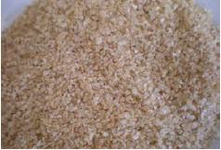
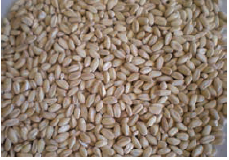
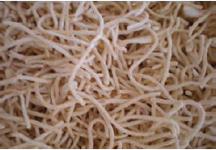
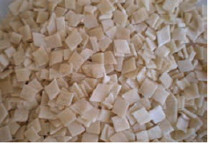
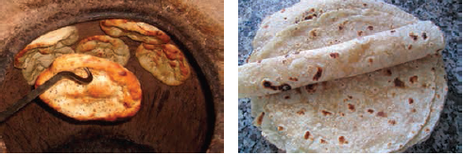
Wheat end products in SE Anatolia
Productos finales de trigo

Slide 45
Current situation in the Fertile Crescent / Situacion actual en FC
Genetic biodiversity lost by 75% in last century (Bettercord,2011)
Inadequate seed multiplication, sale and seed swap
Less practice in conservation breeding of landraces due to aging old farmers
Shifting of some allele combinations in time resulted in genetic erosion

Slide 46
Landrace abolish in 2000-2004 in Syria, Jordan, Lebanon, and Palestine
Jordan : acreage 0.5% decrease
Lebanon acreage 41% decrease
Palestine : 15% decrease
Syria: 40% decrease (Mazid ve ark., 2013)
Household quitting landraces (%)
Jordan: 6%
Lebanon19%
Palestine 10%
Syria: 4% (Mazid ve ark.,2013)

Slide 47
Still grown landraces in SE Anatolia / Variedades locales todavía cultivadas en SE Anatolia
Until in near past (DW): Bağacak, Sorgül, Beyaziye, Menceki, İskenderi, Mısri, Havrani, Hacihalil
Still;
Devedişi (Gerger), Sorgül (Midyat),
Aşure (Ekm., Elazığ)
Acreage rank in Turkey (Özberk ve ark., 2016):
1. Zerun, 2. Akbuğday, 3. Kırmızı buğday , 4. Sarı buğday, 5. Karakılçık, 6. Kırik, 7. Siyez, 8. Koca buğday, 9. Topbaş, 10. Şahman, 11. Üveyik

Slide 48
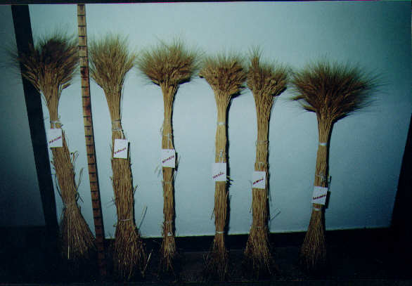
Near past landraces grown in SE Anatolia

Slide 49
Still grown landraces in FC / Variedades locales todavía cultivadas
Syria:
Haurani B, Haurani 27, Haurani A, Haurani Normal, Kısa Haurani, Faroni, Koko
Hamari, Jidouri, Zedi, Gharbi, Joulani, Jabali, Siklawi

Slide 50
Still grown landraces in FC
Jordan;
Ajloun local durum landraces
7
Karak DW: 5
Labenon: Salamouni (BW)

Slide 51
Disposition/ disposición
1. Historical background / Antecedentes históricos
2. Landraces and characteristics / Variedades locales y características
3. Current situation / Situación actual
4. Future trends / Futuras tendencias

Slide 52
How to improve biological diversity through landraces? / ¿cómo mejorar la diversidad biológica mediante variedades locales?
Improvement in drought tolerance (Kyzeridis ve ark.,1995)
Improvement resistance or tolerance to some pest and diseases (Talas ve ark.,2011)
Improved adaptation to low input environments (Srivastava ve damania,1989)
Solution; Combination breeding.

Slide 53
Conservation of landraces / Conservación de variedades locales de trigo
Until now, landraces survived due to;
Adaptation to local eco-geography,
Suitability to local socio economical conditions
Yield stability
(Rijal, 2010; B,shaw, 2010 ve 2011; Mazid ve ark., 2013; Carvalho ve ark., 2013).

Slide 54
Conservation of landraces
These are not good enough to conserve them forever,
In order to sustainable conservation (Karagöz, 2016)
1. Find new marketing areas and new end products from landraces
2. Keep traditional culture alive,
3. Farmer participation in variety improvement activities and on farm conservation strategies,
4. Facile seed sharing systems for landraces

Slide 55
Conservation of landraces
5. Improvement of field mixture strategies of landraces (einkorn + emmer)
6. Law for seed certification must be modified (genetic homogeneity must be discarded for landraces)
7. Organic crop production through landraces must be encouraged
8. Quality researches for landraces must be increased

Slide 56
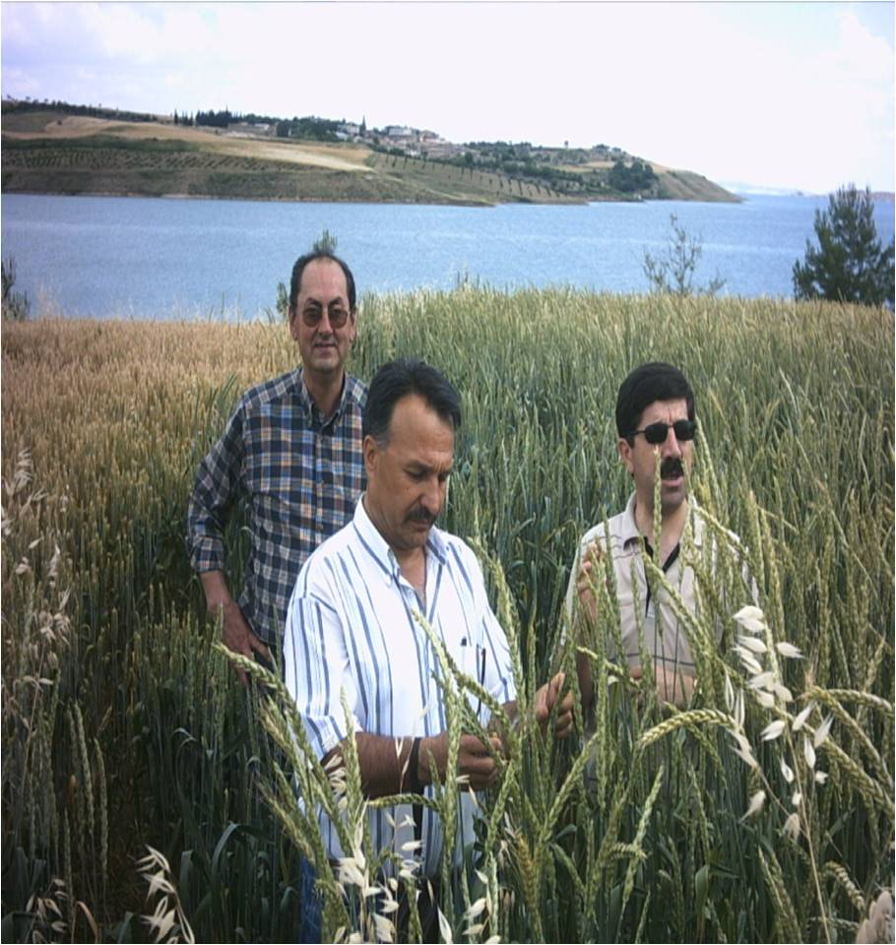
Last word / La última palabra…..
Conservation of landraces and local culture is vital for mankind future…
Thanks for your patience....
Gracias por su atención..
Dişbudak, BW landrace, Adıyaman

